Slide 1
Cloud Computing and GIS
IT4GIS
Keith T. Weber, GISP
GIS Director
ISU-GIS Training and Research Center

Slide 2
Goal of this presentation
Describe and demystify “The Cloud”
  What is it?
  How is it different from “web services”?
  ROI and TCO case studies

Slide 3
What is The Cloud
Once upon a time…
  Sam the server man discovered his servers were underutilized
  To optimize their utilization rate, he made his servers available to others
  This was really nothing new, as ISP’s had been around for decades

Slide 4
But…
Sam’s Servers did more than just host HTML pages, they also:
  Provided infrastructure solutions
  And hosted services that his customers were not capable of hosting
  Essentially, they were “servers for rent”
This commercialization of web service hosting became known as…

Slide 5
Cloud Computing

Slide 6
What goes on behind the cloud?

Slide 7
By Definition
Cloud computing is…
  On-demand
  Self-service services
  Delivered in a metered fashion via a network (i.e., the Internet)
Cloud computing follows…
  A multi-tenancy model
  Within a virtualized, elastic environment

Slide 8
Terms

Slide 9
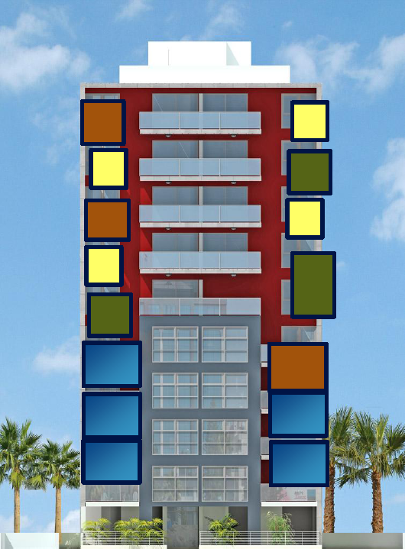
Multi-tenancy
Virtualized servers are used by many

Slide 10
Virtualization
Similar to logical hard drives, virtualization converts one physical server into many (virtual) servers
Doing this requires:
  Physical host server
  Host OS + Virtualization software (e.g., Hypervisor, Hyper-V)
  Management suite software

Slide 11
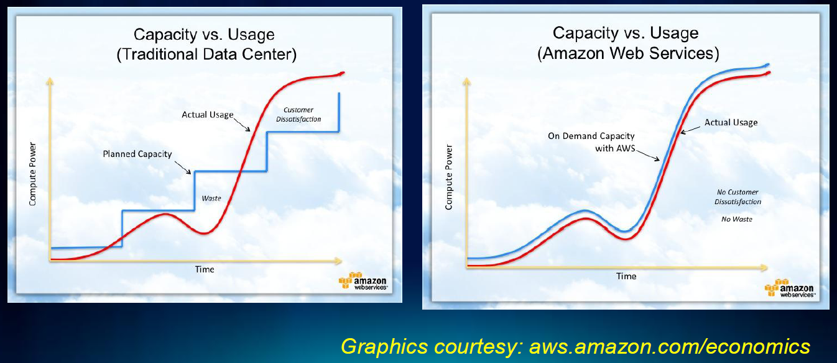
Elasticity
Similar to scalability

Slide 12
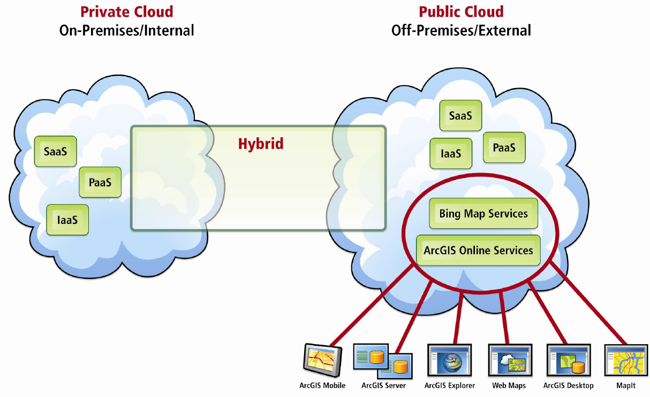
Cloud Deployment Models

Slide 13
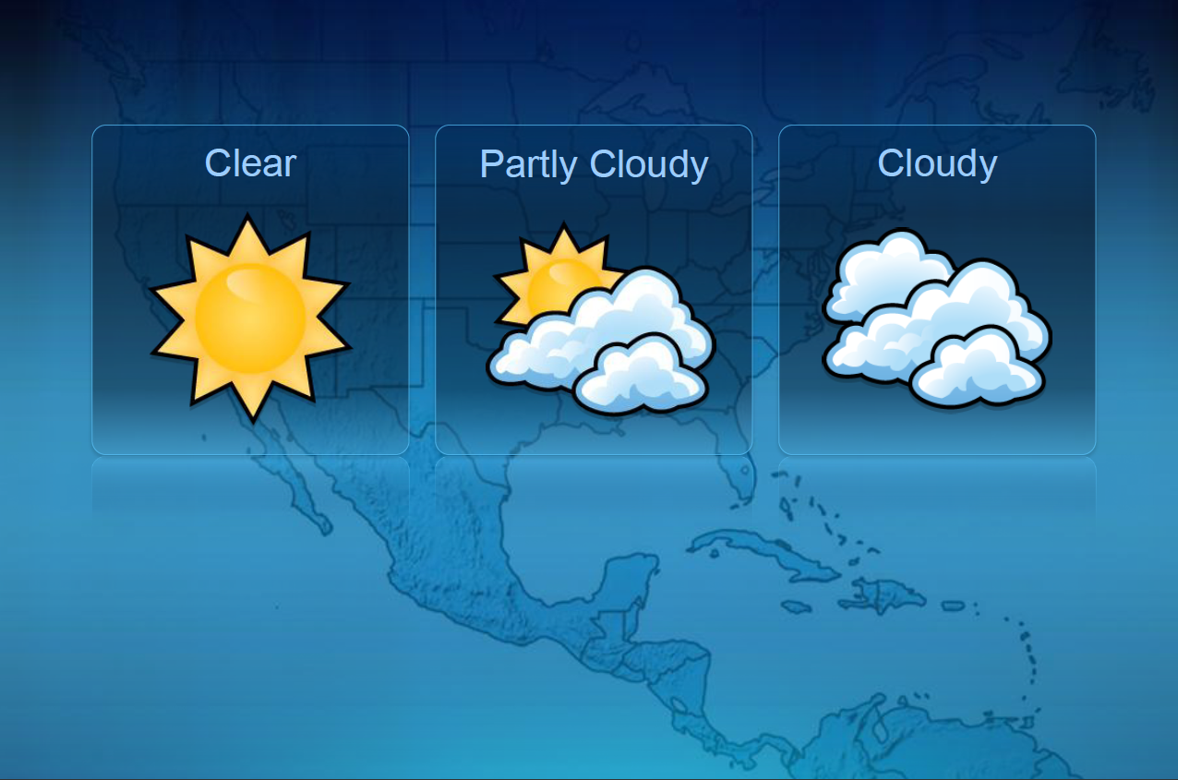
The Hybrid Model

Slide 14
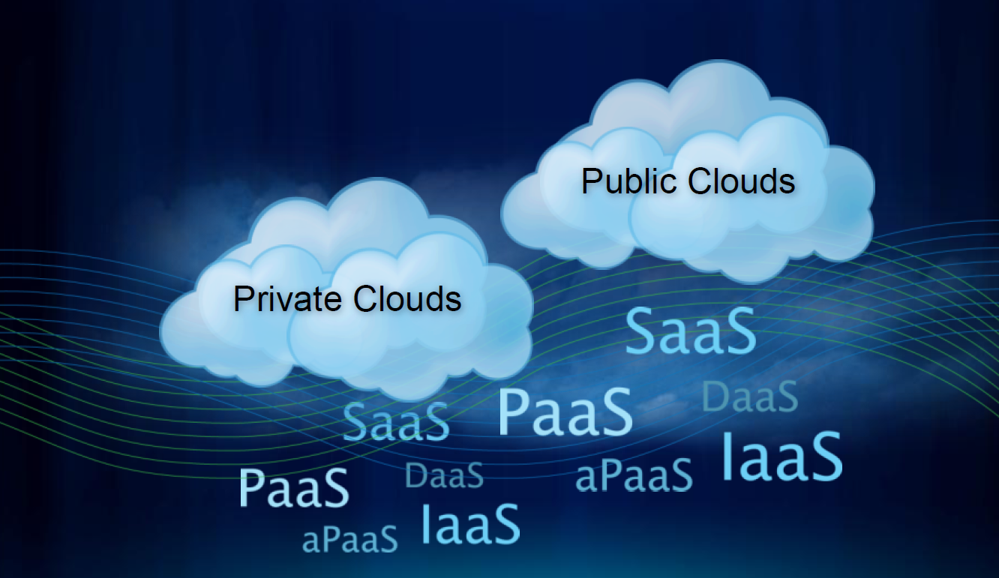
What services are offered in the Cloud?
If its not html hosting, what services are offered?

Slide 15
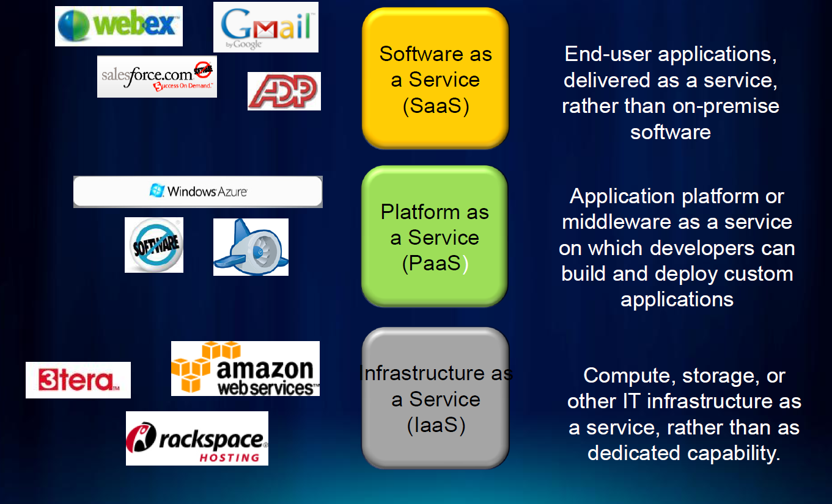
aaS
as a Service

Slide 16
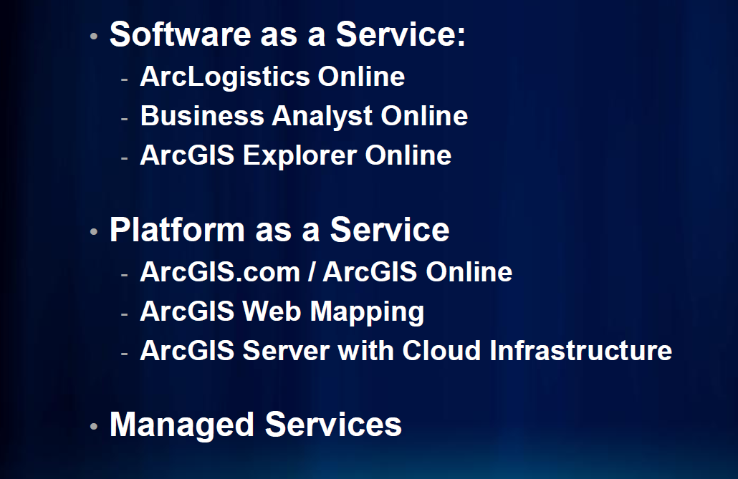
Where does GIS fit aaS?
Brainstorm…

Slide 17
SaaS and the Changing Face of Software
An increasing number of software applications are hosted in the cloud (SaaS)
They are offered as a subscription to the end user
They are, of course, dependent upon a good Internet connection to function
They also put the software developer in charge! Consider this:
  Compatibility with third party apps/automation scripts
  Compatibility with Enterprise business constraints

Slide 18
Real Concerns?
Brainstorm!
To learn more about this watch this TECH talk, Connecting GIS (https://youtu.be/lwQDb2oTzQ0)

Slide 19
How does The Cloud differ from Web Services we already learned about?
Brainstorm
By definition cloud computing is…
  On-demand
  Self-service services
  Delivered in a metered fashion via a network (i.e., the Internet)
Cloud computing follows…
  A multi-tenancy model
  Within a virtualized, elastic environment

Slide 20
Let’s Compare
Cloud Servers
Virtualized Servers
On-demand
Self-service
Delivered in a metered fashion
Multi-tenancy
Virtualized
Elastic
On-demand
Self-service
Delivered in a metered fashion
Multi-tenancy
Virtualized
Elastic

Slide 21
ROI and TCO Scenarios
TCO?
ROI…
  Case study #1, a small Idaho county wants to make GIS maps of the county available via the web
  Case study #2, large research university wants to make GIS maps available via the web

Slide 22
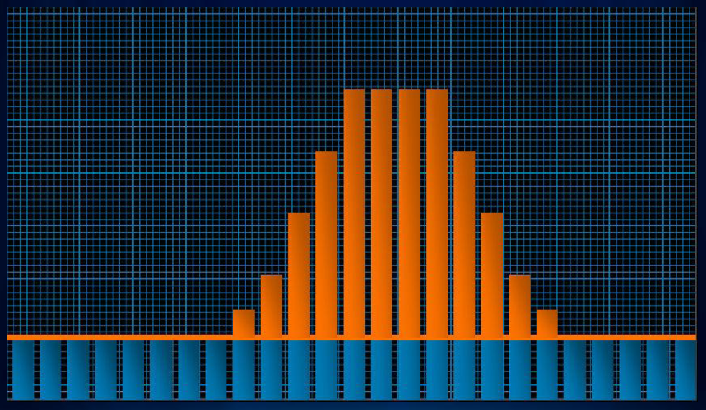
The Partly Cloudy Approach
Own the base, rent the spike

Slide 23
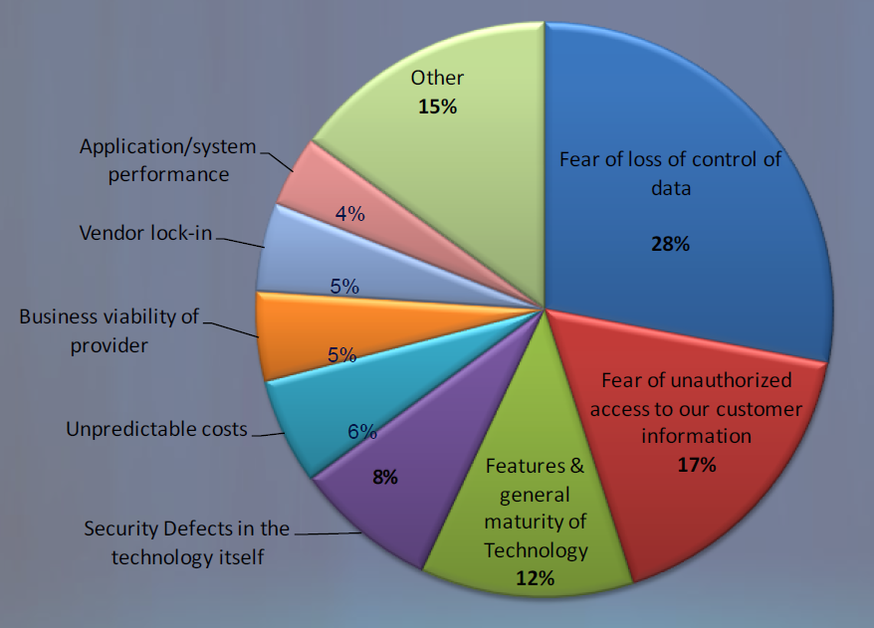
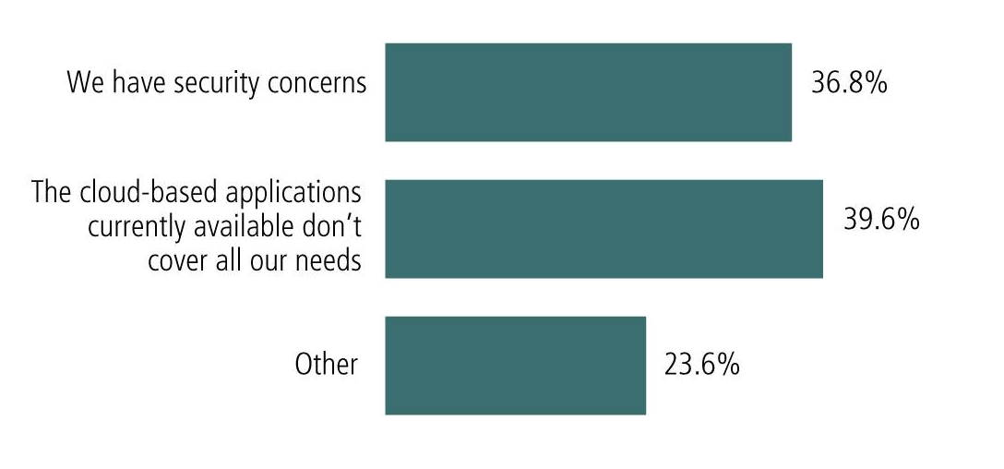
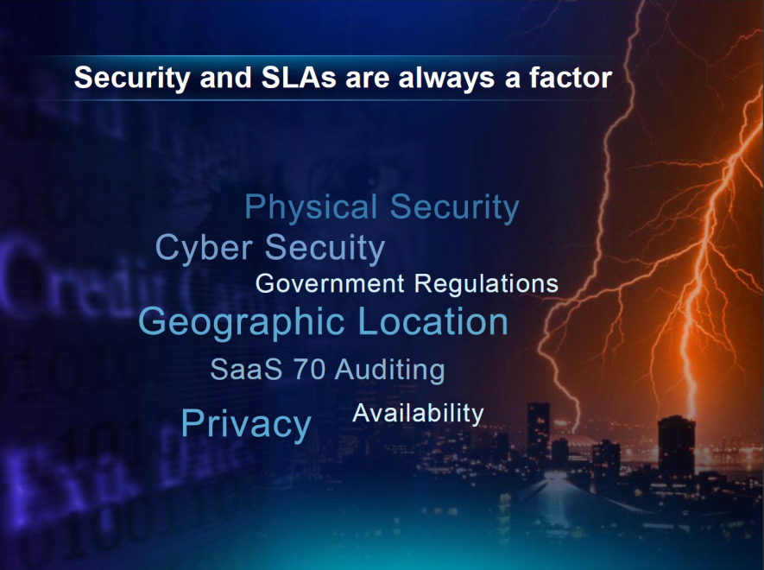
Considerations
Reasons for not using the cloud
  Security
  Service Level Agreement

Slide 24
High Performance Computing
PART TWO

Slide 25
Goal of this presentation
Introduce you to an another world of computing, analysis, and opportunity
Encourage you to learn more!

Slide 26

Some Terminology Up-Front
Supercomputing
HPC
CI

Slide 27
Acknowledgements
Much of the material presented here, was originally designed by Henry Neeman at Oklahoma University and OSCER

Slide 28
What is Supercomputing?
Supercomputing is the biggest, fastest computing today.
Likewise, a supercomputer is one of the biggest, fastest computers today.
So, the definition of supercomputing is constantly changing.
Rule of Thumb: A supercomputer is typically 100 X as powerful as a PC.

Slide 29
What is a Supercomputer?
A cluster of small computers, each called a node, hooked together by an interconnection network (interconnect for short).
A cluster needs software that allows the nodes to communicate across the interconnect.
But what a cluster is … is all of these components working together as if they’re one big computer ... a super computer.

Slide 30
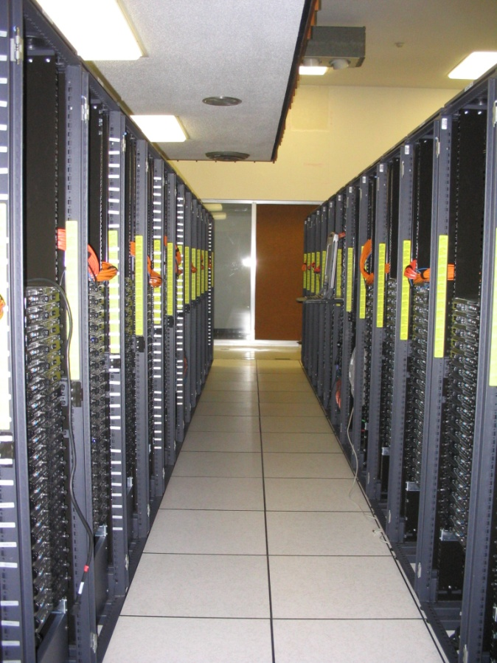
For example: Dell Intel Xeon Linux Cluster
1,076 Intel Xeon CPU chips/4288 cores
8,800 GB RAM
~130 TB globally accessible disk
Linux OS
Peak speed: 34.5 TFLOPs*
  *TFLOPs: trillion floating point operations (calculations) per second
sooner.oscer.ou.edu

Slide 31
What is Supercomputing About?
Size
Speed
Laptop

Slide 32
Size…
Many problems that are interesting to scientists can’t fit on a PC
  usually because they need more than 32 GB of RAM, or more than a few TB of disk.

Slide 33
Speed…
Many problems that are interesting to scientists and engineers would take a long time to run on a PC.
  Days, weeks and even months.
  But a problem that would take 1 month on a PC might take only a few hours on a supercomputer
How can a supercomputer do this?

Slide 34
Parallelism
How a cluster works together:

Slide 35
Parallelism
Parallelism means doing multiple things at the same time
Less fish …
More fish!

Slide 36
The Jigsaw Puzzle Analogy
Understanding Parallel Processing

Slide 37
Serial Computing
We are very accustom to serial processing. It can be compared to building a jigsaw puzzle by yourself.
Suppose you want to complete a jigsaw puzzle that has 1,000 pieces.
This will take a certain amount of time…let’s just say, one hour

Slide 38
Shared Memory Parallelism
If Scott sits across the table from you, then he can work on half the puzzle and you can work on your half.
Once in a while, you’ll both reach into the pile of pieces at the same time (you’ll contend for the same resource), which will cause you both to slowdown.
And from time to time you’ll have to work together (communicate) at the interface between his half and yours. The speedup will be nearly 2-to-1: Together it will take about 35 minutes instead of 30.

Slide 39
The More the Merrier?
Now let’s put Paul and Charlie on the other two sides of the table.
Each of you can work on a part of the puzzle, but there’ll be a lot more contention for the shared resource (the pile of puzzle pieces) and a lot more communication at the interfaces.
You will achieve noticeably less than a 4-to-1 increase in speed.
But you’ll still have an improvement, perhaps 20 minutes instead of 1 hour.

Slide 40
Diminishing Returns
If we now put Dave, Tom, Horst, and Ella at the corners of the table, there’s going to be a much more contention for the shared resource, and a lot of communication at the many interfaces.
The speedup will be much less than we’d like; you’ll be lucky to get 5-to-1.
Adding more and more workers to a shared resource is eventually going to have a diminishing return.

Slide 41
Distributed Parallelism
Let’s try something a little different.
  Set up two tables
  You will sit at one table and I will set at the other.
  We will put half of the puzzle pieces on your table and the other half of the pieces on my end of the table
Now you can work completely independently, without any contention for a shared resource.
BUT, the cost of communication is MUCH higher, and you need the ability to split up (decompose) the puzzle pieces correctly.

Slide 42
More Distributed Processors
It’s easy to add more processors (these are the people assembling the puzzle) in distributed parallelism.
But you must be aware of the need to:
  decompose the problem and
  Allow for communication among/between the processors.
Also, as you add more processors, it may be harder to load balance the amount of work that each processor gets.

Slide 43
Why Parallelism Is Good
As the number of processing units working on a problem grows, we can solve:
  The same problem in less time (think of a tree)
  Bigger problems (think of a forest)

Slide 44
GIS Applications?
Can you think of a GIS workflow that could be parallelized easily?
  Lidar

Slide 45
Interested? Curious?
To learn more, or to get involved with supercomputing there is a host of opportunities awaiting you
  Get to know ISU’s Campus Champions
  Ask about internships at INL C3
  Learn C (not C++, but C) or Fortran
  Learn UNIX (Linux)

Slide 46
Questions?
Time for our final 2-minute Write!

