Slide 1
Data Science and
Data Engineering
Keith T. Weber, GISP
ISU GIS Director
GIS Training and Research Center

Slide 2
Data Science
A growing field
  Interdisciplinary
  Seeks to extract information from data
  Born from Big Data/unstructured data
  NOTE: 80% of data is considered unstructured data
Spatial Data Science
  A more specialized sub-field of data science

Slide 3
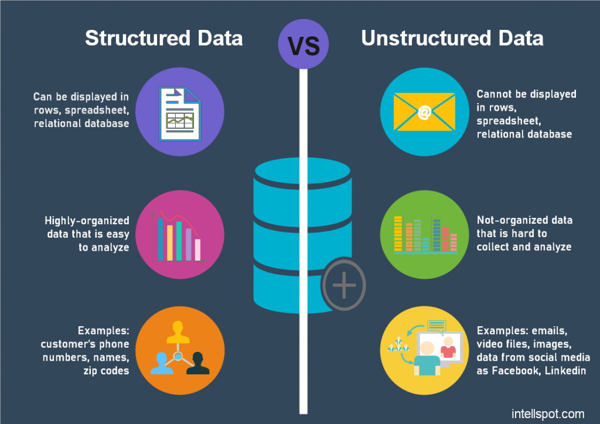
Structured vs. Unstructured Data

Slide 4
Structured vs. Unstructured Data (cont’d)
This semester, we have focused on structured data
How can we work with unstructured data, especially in GIS
  This is a task for Data Engineering tools and techniques

Slide 5

First, Take out the Trash
Some data is really is trash!
  How to identify trash
ROT
  Redundant
  Obsolete
  Trivial
This Photo by Unknown Author is licensed under CC BY-SA

Slide 6

Second, Use these Keys to Unlocking Unstructured Data
Understand, it is not as unstructured as you may think
  A social media feed is not just a collection of words
  The digital file behind the scenes contains much more
    Metadata (author and date)
    Message Content (text, recipient, hyperlink, image, hashtag)
    Interactions (reposts, favorites, replies)

Slide 7
Posts are Machine-Readable
Using Esri’s GeoEvent server, a server can read X posts and filter them
  Filtering is the second key to unlocking unstructured data
  In other words, identify data of interest (e.g., Posts with a hashtag #GISDay)
  When written to a database, these data become structured

Slide 8
Structured Spatial Data from Email
There are approximately 300 billion emails sent each day
Each email (without attachments) is approximately 500 bytes in size
  150 trillion bytes
  146 billion KB
  136 TB
In one year, harvesting and storing all emails would require:
  0.05 EB (1/10th of an Exabyte)

Slide 9
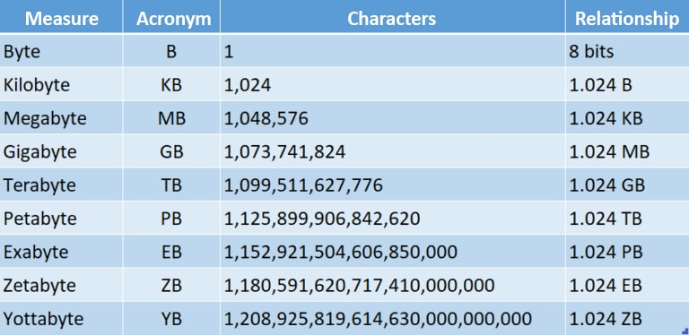
All Emails can be stored for a very long time
For example, it is estimated NSA data centers can store 1 (or more) Yottabytes of data
  Thus, a 12 EB data center can store all emails for 250 years, OR
  Store all emails for 25 years AND
  All social media posts for 25 years, etc.

Slide 10
Finding the Needle in the Haystack
Finding the needle of information in a haystack of data
  HINT: go back to KEY #1
  Learn the structure of the data
  Develop and further mature/evolve search tools

Slide 11
Learning the Structure of an Email
220 {smtp-server-fqdn} ESMTP
EHLO {yourdomain.ext}
{smtp-server-fqdn}
250-PIPELINING
250-SIZE 40960000
250-ETRN
250-STARTTLS
250-AUTH PLAIN LOGIN
250-AUTH=PLAIN LOGIN
250-ENHANCEDSTATUSCODES
250 8BITMIME
HELO {yourdomain.ext}
250 {smtp-server-fqdn}
AUTH LOGIN
334 VXNlcm5hbWU6
{username|base64}
334 UGFzc3dvcmQ6
{password|base64}
235 2.7.0 Authentication successful
MAIL FROM: <someone@sender-fqdn>
250 2.1.0 Ok
RCPT TO: <someone@recipient-fqdn>
250 2.1.5 Ok
DATA
354 End data with <CR><LF>.<CR><LF>
From: "{VanitySenderName}" <someone@sender-fqdn>
To: "{VanityRecipientName}" <someone@recipient-fqdn>
Subject: {subject}
Date: {date}
{message body}
.
250 2.0.0 Ok: queued as {identifier}
QUIT
221 2.0.0 Bye
<ctrl>+<c>
DATA is a keyword
  Extract all text following DATA
  FROM field (text data type)
  TO field (text data type)
  SUBJECT (text data type)
  DATE (date data type)
  Next is the body of text (text data type or CLOB data type)

Slide 12
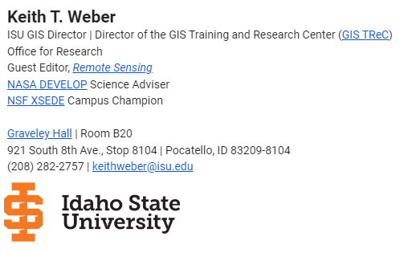
Emails are Not Spatial Data!
Do you use a signature line?
Do you mention places in your emails?
  Subject line of email
  “Boise visit”
  “Vacation photos from Italy”
  Classify Text Using Deep Learning
Do you send emails from your smart phone?

Slide 13
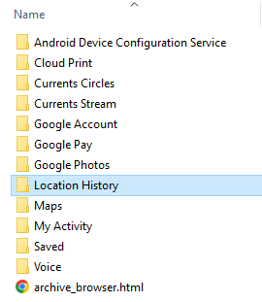
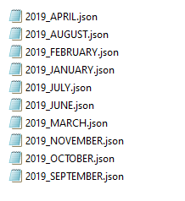


Spatial Data from Web Browsers and Smart Phones
For Example, Google (Android smart phones and ISU’s email/browser system) collects and stores a lot of data about you

Slide 14
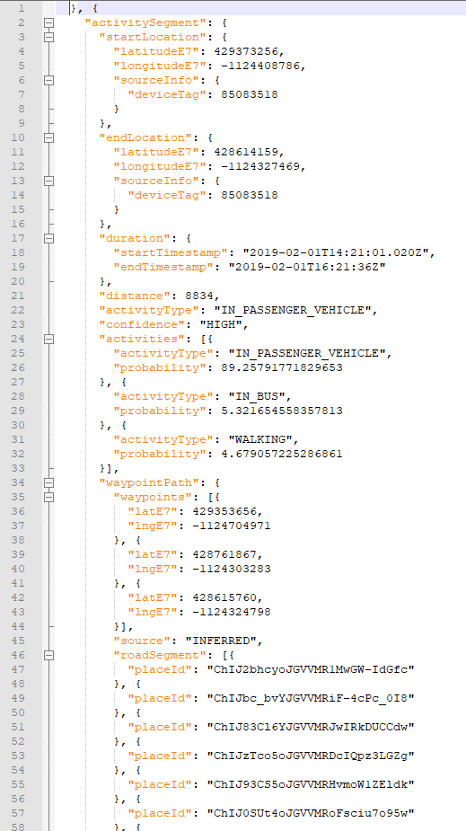
Let’s look at one of these JSON files
Look for keywords or something that can be used to parse these data
BRAINSTORM…

Slide 15
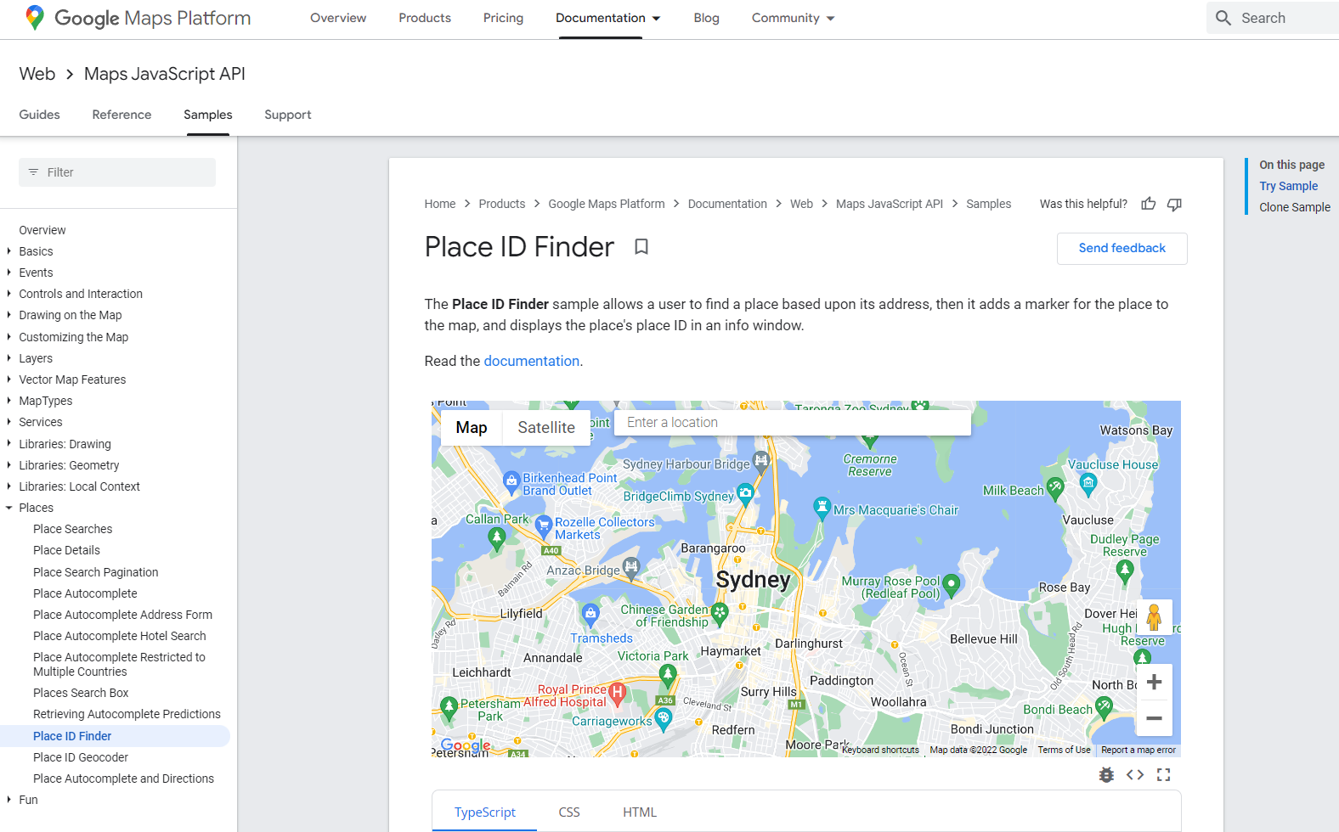
What is PlaceID?
https://developers.google.com/maps/documentation/javascript/examples/places-placeid-finder

Slide 16
How Accurate are these Locations?
latitudeE7: 428614159, longitudeE7: -1124327469
In other words:
  42.8761416°
  -112.4327469°
Now its easy!
  Any programmers out there?
  MS Excel enthusiasts?
  How about ArcGIS Pro?

Slide 17
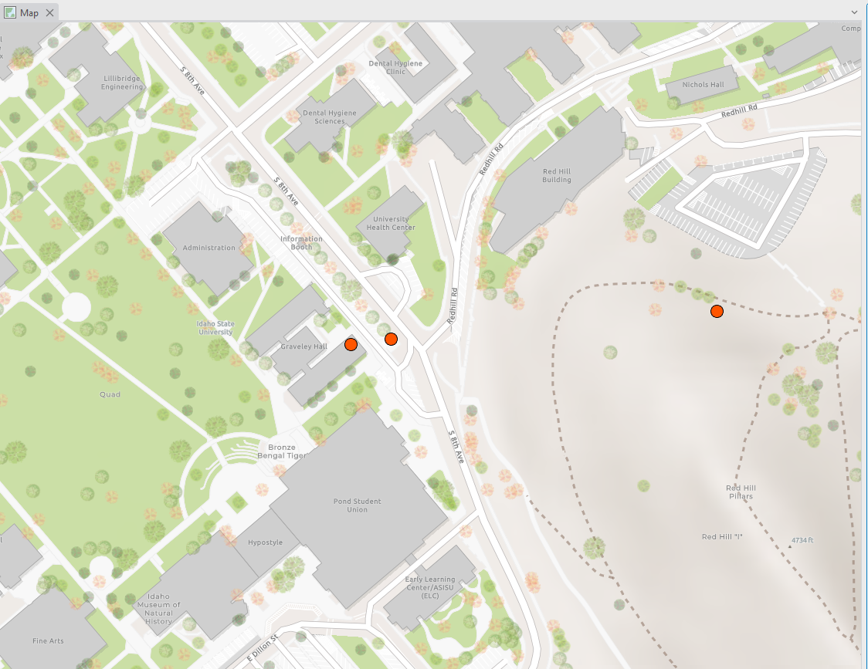
Google Location Data in ArcGIS Pro

Slide 18
Location Precision
Everyday, everyone’s location can be tracked (well, your smartphone’s location is tracked)
Limitations:
  I did not find data stored for a full 24 hrs.
  BUT only when I had LOCATIONS turned on
PS- These data are stored for a long time (I got my first Android smart phone in 2013)

Slide 19

Information from Imagery
This Photo by Unknown Author is licensed under CC BY

Slide 20
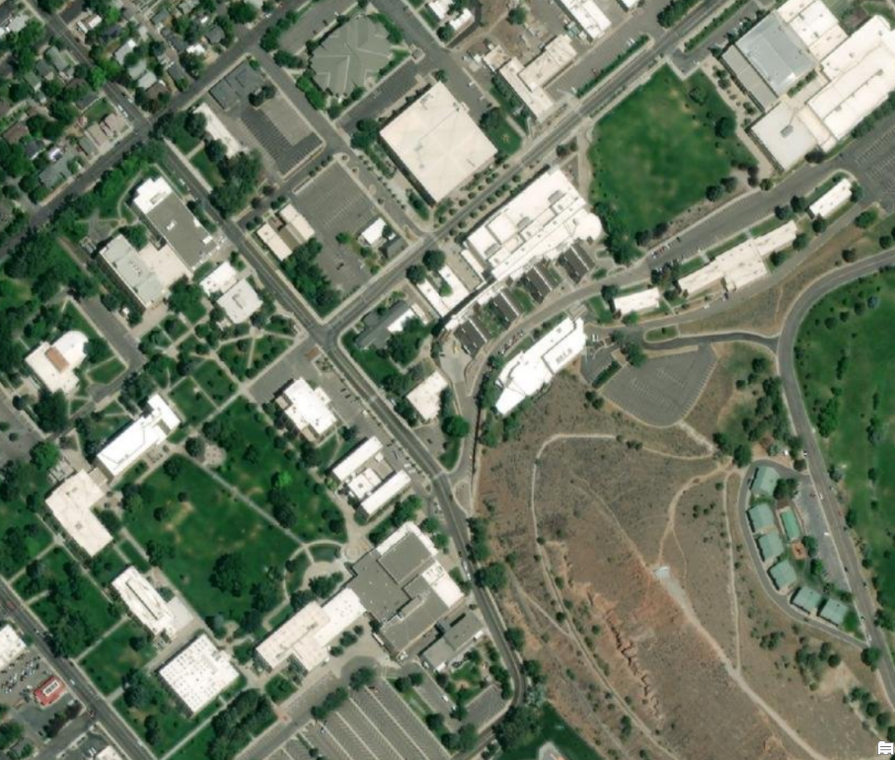
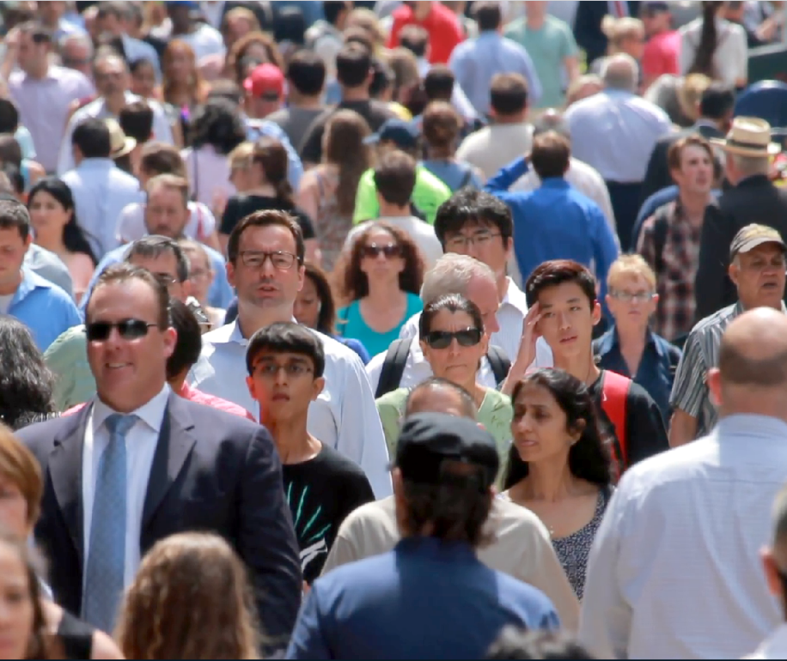
Remote Sensing and The IoT
IoT is the Internet of Things
Object/Feature Extraction with ArcGIS Pro
  Detect Objects Using Deep Learning
Map buildings
Identify people
Gait analysis

Slide 21
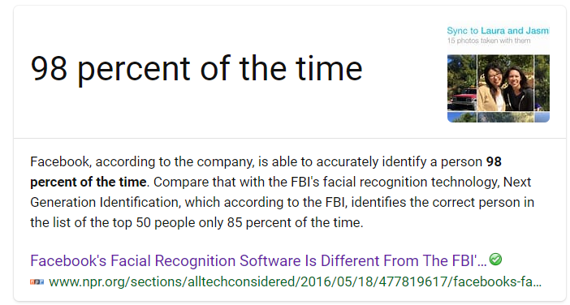
Facial Recognition
In 2016, Facebook boasted its facial recognition had 98% accuracy

Slide 22
Advanced Data Engineering Heightens the Need for Professional Ethics
Advantages of harvesting data
Disadvantages of harvesting data
Brainstorm
Brainstorm

Slide 23

Key Concepts
Gleaning information from unstructured data is an emphasis area in Data Science
New, powerful tools leveraging artificial intelligence algorithms are emerging and maturing
Knowing WHERE makes data much more valuable
Data is considered an asset, Information is a valuable asset
High spatial and temporally resolved data requires care to avoid unethical use of these tools/resulting data

Slide 24
Professional Hints and Tips
Building a great resume
  Promote your skillset
  Introductory sentence
  Don’t misrepresent yourself
  Aesthetics

Slide 25

Questions/Discussion?

