Slide 1
Web Map Applications:
The Geo-Web Revisited
IT4GIS
Keith T. Weber, GISP
GIS Director
ISU-GIS Training and Research Center

Slide 2
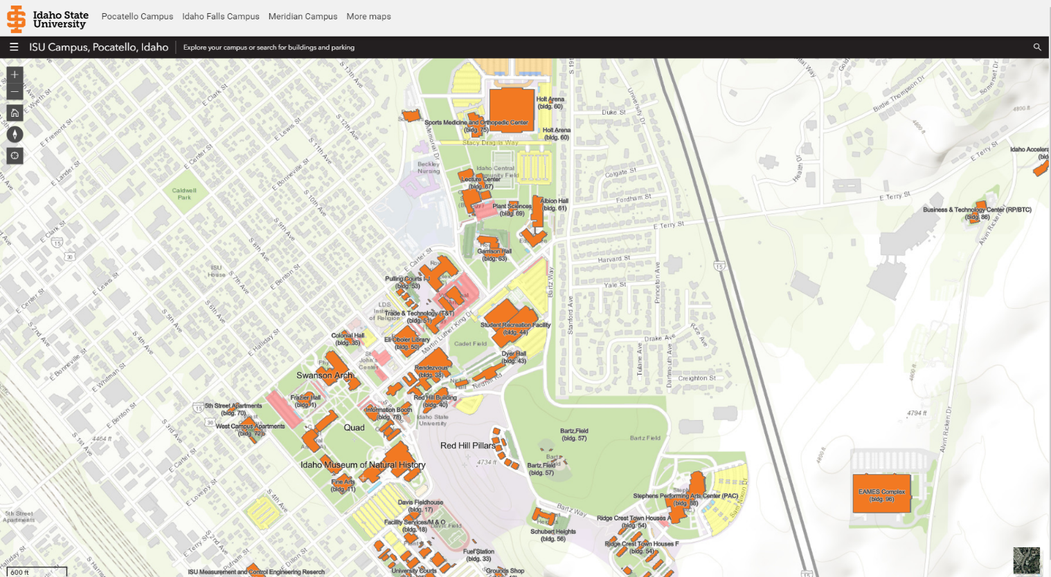
Web Map Apps
In the first part of our exercise, you visited some web map applications

Slide 3
What’s a Web Map App?
Web Map Apps rely on a browser and “wrapper software” to deliver GIS content to the client
It is the browser that “consumes” the web map service
Web Map Apps are frequently “mash-ups” of various web map and web image services
Wrapper software is a generic term referring here to software like ArcGIS Portal that uses Java Scripts to draw maps and provide map content

Slide 4
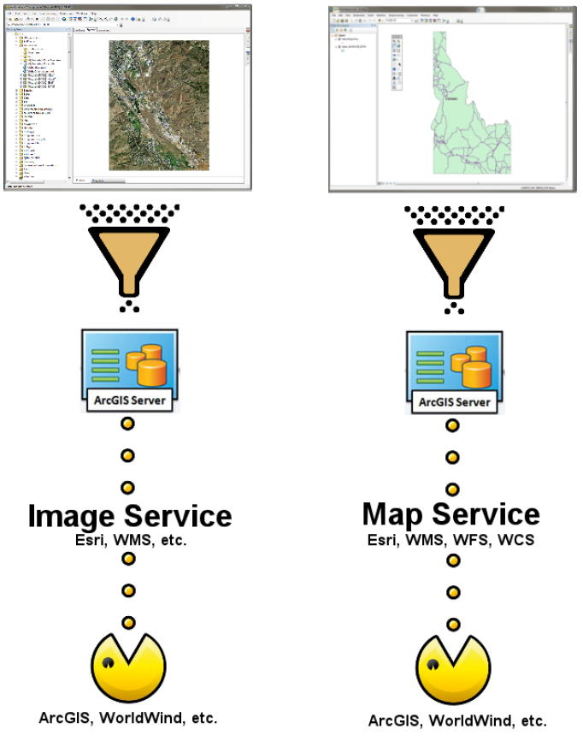
Service Architecture

Slide 5
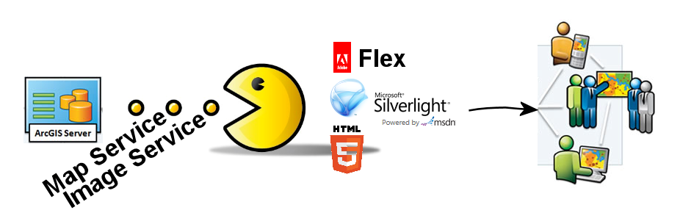

Putting Smart Maps on the Web
Browsers (FireFox, Edge, Chrome, etc.) cannot consume map services directly
They need something (wrapper software) to prepare these data for consumption

Slide 6
Which Wrapper…
Which Environment will we use?
  Adobe Flex
  MS Silverlight
  JavaScript
  HTML 5
  Portal (aka, ArcGIS Online (AGOL))

Slide 7
AGOL Architecture
AGOL is a cloud resource
  ISU’s AGOL presence is called gISU
  Each of you already has a user account on gISU
  gISU is allowed 50,000 user accounts
  gISU is allowed 5,000,000 credits under our site license

Slide 8
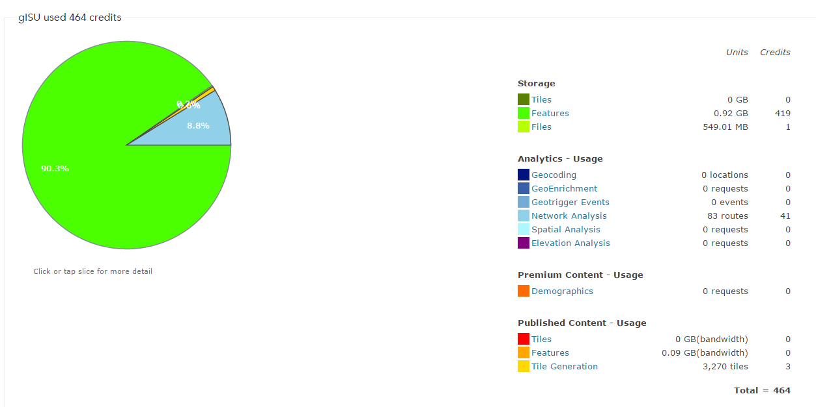
Credits: Things you Need to Know!

Slide 9
Credits: Things you Need to Know!
Storing geospatial data in the AGOL cloud costs credits
Creating and storing TILES in the AGOL cloud costs LOTS of credits
Raster layers are not allowed in AGOL (based on ISU’s license agreement)
What do we do???

Slide 10
Leverage All Our Resources
Create and store OUR big geospatial data on OUR server
  The GIS TReC’s Portal
Create web services for these Big Data (map/image services) on OUR server
Share the service end-points (URL) with AGOL (gISU)

Slide 11
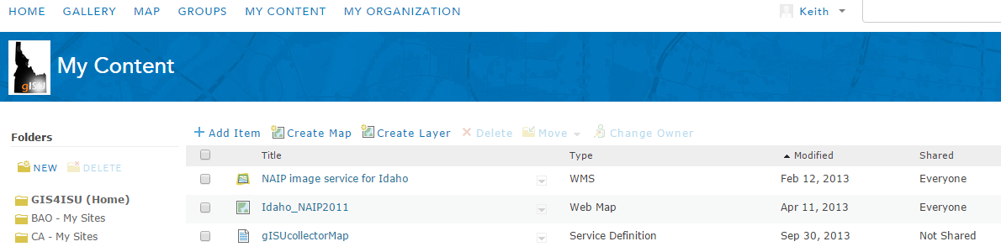
How?
AGOL– My Content– Add Item

Slide 12
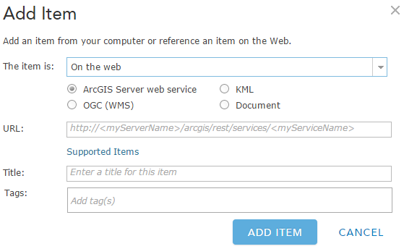
How to…
The ITEM URL expects a REST or SOAP end-point

Slide 13
How Do I Find My End-point?
Access Portal from a web browser
  Log-in
  View your Content
  Select the web layer of interest
  Copy its REST end-point

Slide 14
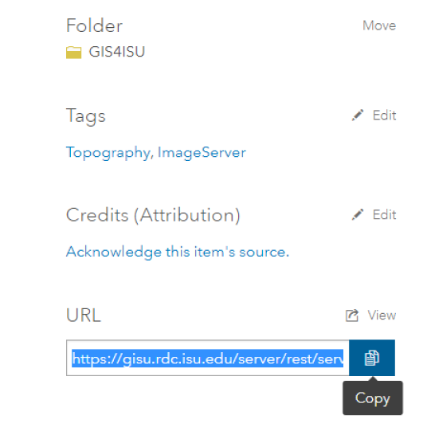
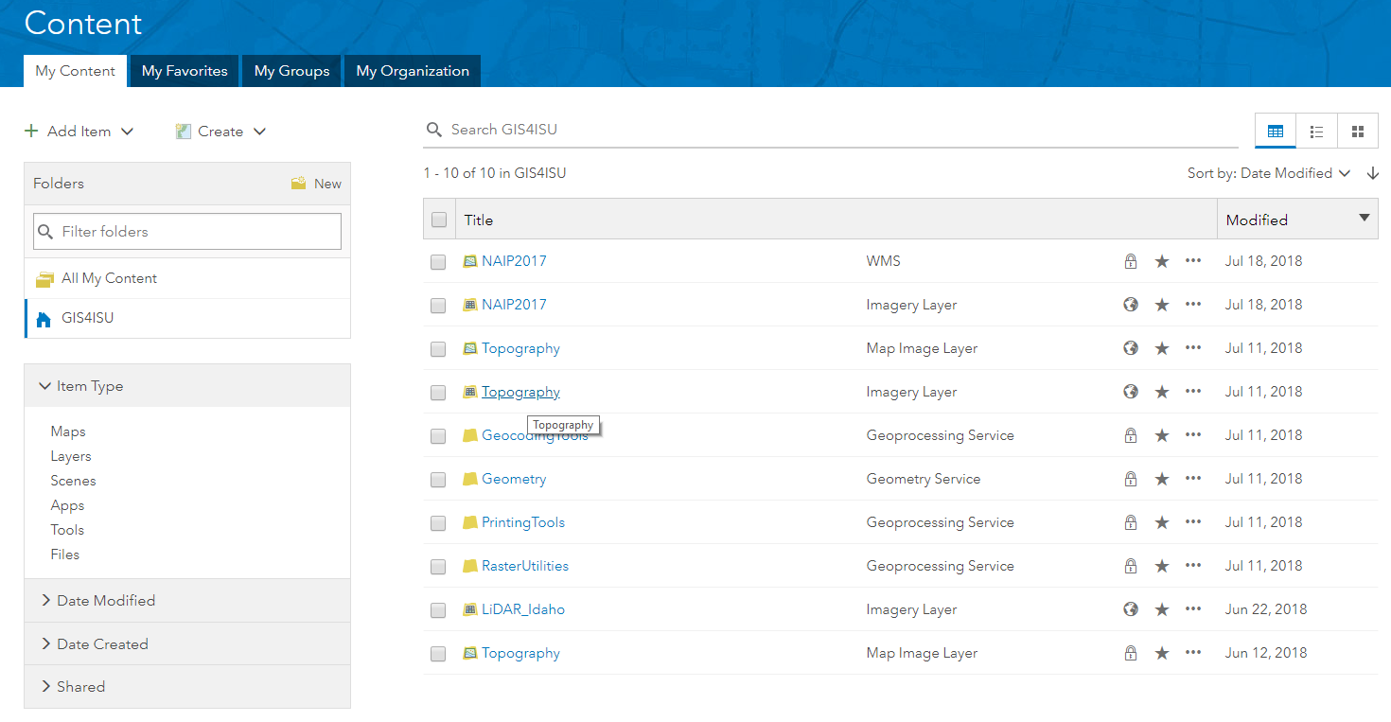
How Do I Find My End-point?

Slide 15
Copy and Paste
Copy the REST end-point
Add an item and paste the REST end-point into AGOL
This Adds the Item to your AGOL account

Slide 16
Time to Share
From AGOL, share your item!
  Once you add an ITEM to AGOL you can easily share it with others (by named group) or with EVERYONE (public).
  Your source service in portal must also be shared in the same way
  Recall our discussion of permissions from the “Systems Administration” section of this class

Slide 17

Why not use our Portal Directly for Everything
Permissions and firewalls
Visibility and discoverability
PORTAL
BELOW THE RADAR
This Photo by Unknown Author is licensed under CC BY

Slide 18
Tips for Making a Great Web Map
DON’T
  Dump data on the consumer (less is more)
  Include OBJECTID in the pop-up
  Use imagery basemaps
DO
  Use meaningful layer names
  Use meaningful field names
  Carefully craft symbology
  Apply spatial/scale thresholds
  Set a good initial map extent

Slide 19
Now its Time for Cartography
Make your map using AGOL tools
  Explore
  Use Esri’s new Map Viewer
  Have fun!
  Detailed instructions can be found in this week’s exercise document
Since the data are not uploaded to AGOL (it is stored on Portal and shared with AGOL), you will not use any credits!

Slide 20
Professional Hints and Tips
Work Smarter not Harder with a List of Files
  Build a batch file
  Build a Python script
  Build a Macro (Idrisi TerrSet, LAS Tools, etc.)

Slide 21
Questions?

