Slide 1
The Geo-Web: Enabling GIS on the Internet
IT4GIS
Keith T. Weber, GISP
GIS Director
ISU-GIS Training and Research Center

Slide 2
In the Beginning
GIS was independent
The GIS analyst or manager was typically a one-person shop
He/she created the data, analyzed the data, and printed the maps

Slide 3
Along Came the Internet
The proliferation of networks and the Internet caused a chain-reaction
  GIS data became easier to share
  Faster networks with larger bandwidth led to increasingly larger datasets being shared
  Yet, GIS data was stored using a self-service model on the network

Slide 4
Old Habits are Hard to Break
Centralized GIS on the network
  Clearinghouses
  One-stop-shops
Someone was in charge
Notes:
We applied a hierarchical, centralized model to GIS. It was easy. Just like a business or a government, someone needed to be in charge and take custodianship for all this data. So, official clearinghouses were selected and the National Spatial Data Infrastructure was born which required that data comply to a set of standards and the NODE where the data resided needed to be approved and follow a specific structure.

Slide 5
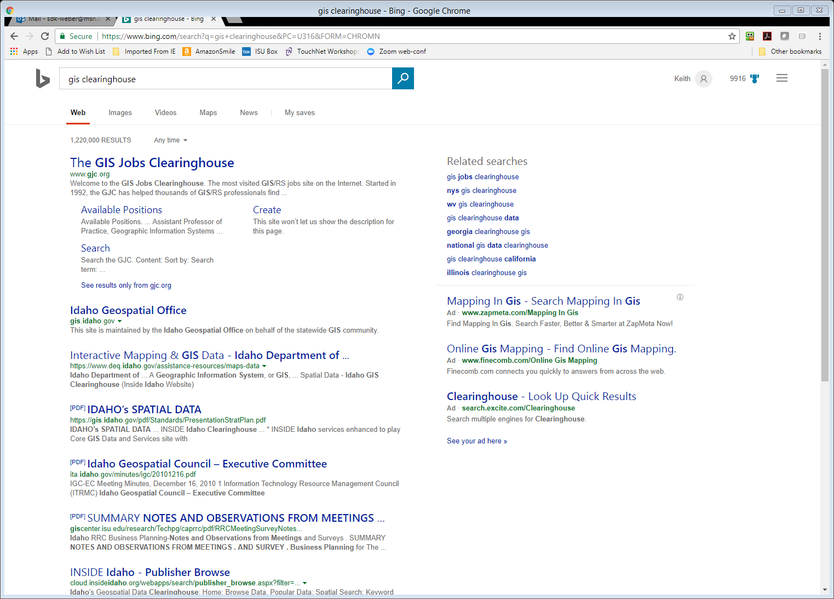
But the One-Stop-Shop Broke
What now?
Re-invent the one-stop-shop
  There are now more than 100,000 GIS clearinghouses
  Each state, large agency, and large company
  Why so many one-stop-shops?
    “Data incompatibilities”
    “Data standards”
    (Control issues)

Slide 6
Control Issues and Fallacies
Protect trade secrets
Ensure data security
Retain intellectual property
--FALSE--

Slide 7
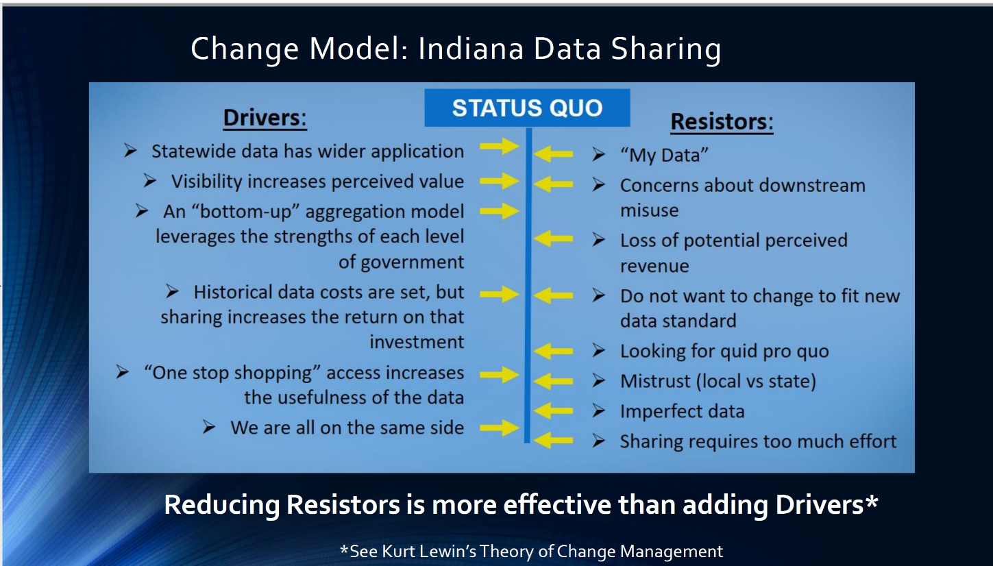

Slide 8
Web 3.0
Semantic web
  Coined by Tim Berners-Lee, the man who invented the (first 1.0) World Wide Web.
  Machine-readable Web pages and semantic metadata
  Support for future AI applications
  “Turns the Web into one big database”
IoT, Internet of Things
  Machine learning and sensor integration

Slide 9
An Interesting Aside
Tim Berners-Lee has more recently called for a change in sovereignty of the web.
  He sees the current Web 2.0 Big Tech Giants as usurpers of the original intent of the Internet

Slide 10
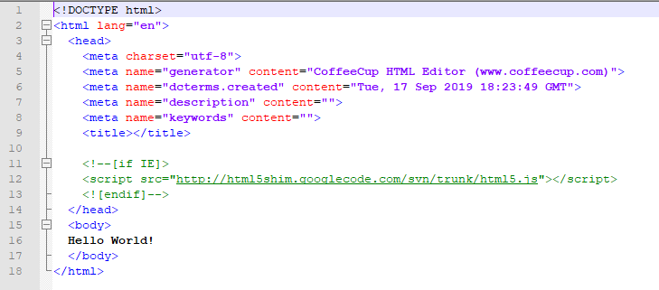
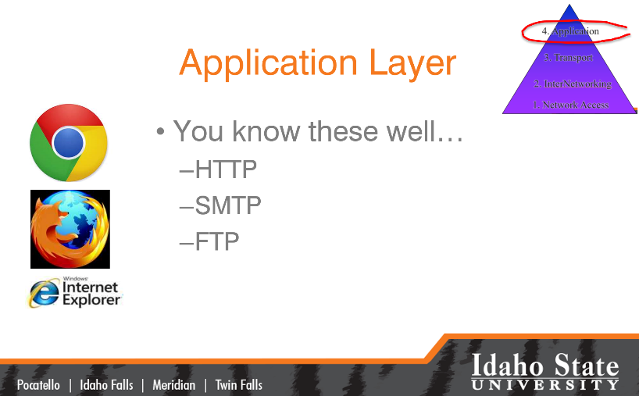
How Might Web 3.0 Work?

Slide 11
Esri’s GeoEvent Server
Unstructured data is streamed into an ArcGIS GeoEvent server
These data are filtered
  Location
  Place
  Other data (keywords)
Resulting records are mapped and can be stored¹ in a geodatabase
1- Based on Service Level Agreement (SLA) or Licensing Agreement

Slide 12
A Grand Experiment
Can the current Web 2.0 and future 3.0 concepts be applied to GIS and spatial analysis… spatial problems?
Can the GeoWeb be built and leveraged to provide real-time decision support?

Slide 13
The Role of GIS
What are we GOOD at?
  Collect spatial data
  Prepare maps and spatial analysis models
  Perform spatial analyses to discover trends, patterns, and relationships

Slide 14
The Role of GIS (cont’d)
Use ArcGIS and web services to make geo-spatial data available to everyone
Transform these data into actionable information to communicate with everyone
[Just because data is available does not make it meaningful information]
Help build the Geo-Web

Slide 15
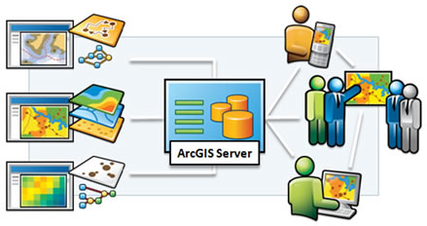
Focusing our Role in IT4GIS
ArcGIS and web services

Slide 16

ArcGIS Enterprise: Architecture
Requirements:
  Network connectivity
  64-bit Windows Server OS
  ArcGIS Desktop software
  ArcGIS for Server software
Notes:
ADF = Application Developers Framework

Slide 17
ArcGIS Enterprise Requires…
Server hardware
  Sufficient hard drive space
  Consider number of expected hits (transactions) when selecting CPU and cache

Slide 18


ArcGIS Enterprise: Architecture (cont’d)
ArcGIS Pro and ArcGIS Enterprise
  ArcGIS Pro is your desktop software
  ArcGIS Enterprise is your server software
  These software technologies are connected via ArcGIS Portal
Notes:
ADF = Application Developers Framework

Slide 19
ArcGIS Portal
Server software providing a user interface
  AGOL is an instance of Portal
Installed and configured as part of ArcGIS Enterprise
  (TIP: Use Esri’s Builder tool to make your first installation/setup easier)
Designed to support the GIS demands of your enterprise

Slide 20
ArcGIS Server is…
Another part of ArcGIS Enterprise
Scalable
Flexible (variety of SDK’s, e.g., Java)
Resulting services are easy for clients to use (easier than ArcGIS Desktop)
Supports Portal for ArcGIS

Slide 21
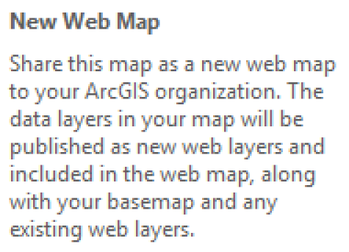
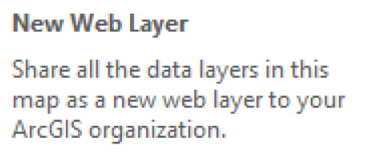
ArcGIS Server can deliver…
Image services
Geodata services
Map services
Geocoding services
Indexing/Search services
WMS Services
KML Services
Notes:
WMS is an internet mapping protocol published by the OpenGIS Consortium. WMS servers publish map images to remote clients using standard internet technologies. There are WMS servers for LandSat data, USGS DOQ photos, bathymetry, and many other data types.
Web Map Services
KML, or Keyhole Markup Language , is an XML grammar and file format for modeling and storing geographic features such as points, lines, images, polygons, and models for display in Google Earth and Google Maps

Slide 22
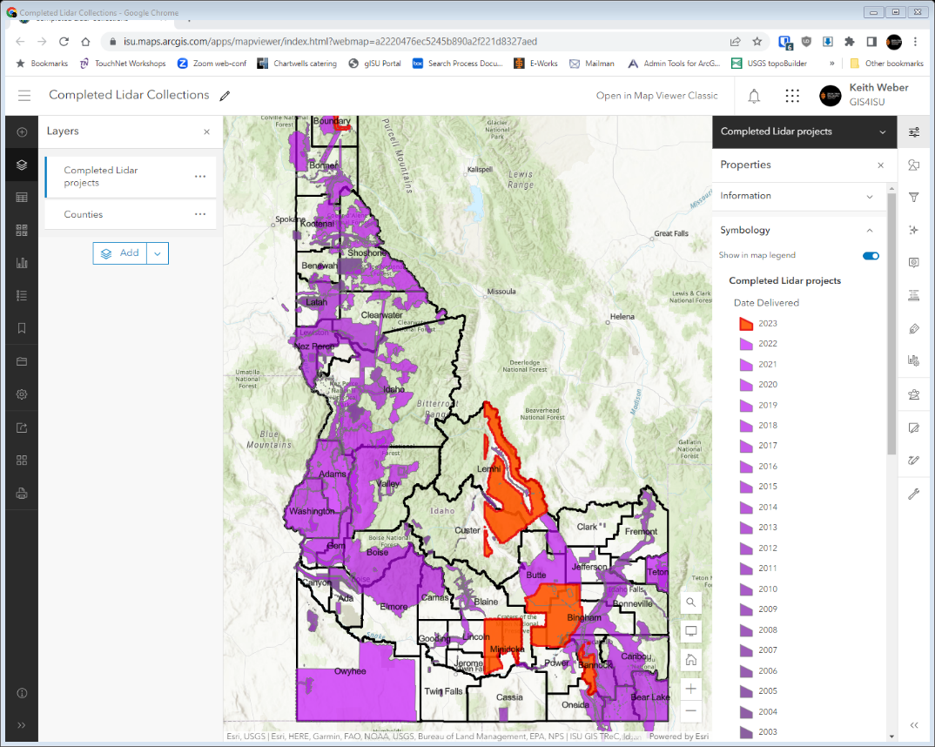
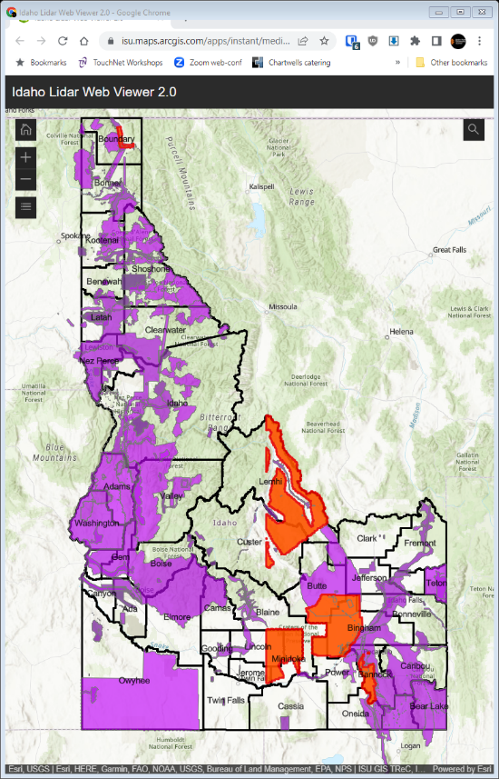
Using a Mash-up of Services…
Web Layers are used to create Web Maps
Web Maps can be used to deliver Web Map Applications

Slide 23
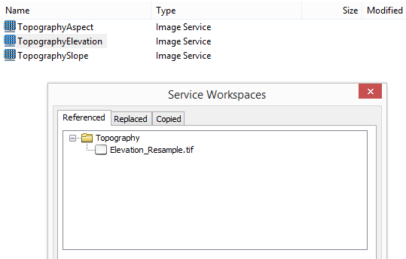
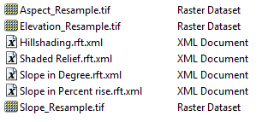
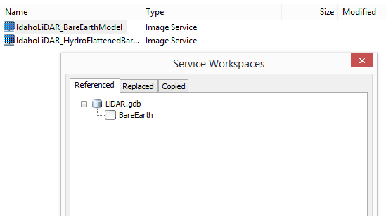
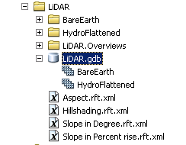
Image Services
Best Practices
  Serve either a:
    Single image file (e.g., GeoTIFF), or
    Raster mosaic dataset w/i fGDB

Slide 24
Raster Mosaic Datasets
A great solution to serve raster data
Performance
  Response
  Cache (no longer needed/used)
  Do you understand client-side caching?
  Overview size
  Developing a map service from these data

Slide 25
Web Image Layers
Service produced when publishing raster data from ArcGIS Pro
AKA “Image Service”

Slide 26
Map Services
Effectively, Map Services (Web Maps or Web Layers) are a type of web service to display an ArcGIS Pro map
Advantages
  Can include numerous layers
  Raster and Vector (based on licensing, raster data may not be supported in your AGOL)
  Retains symbology, scale thresholds, and other settings
  (note: images with ColorMaps, served as Image Services, will retain symbology also)

Slide 27
Process of creating an ArcGIS Web Map and App
Author a map
  Using ArcGIS Pro
Share your project’s Web Map or Web Layer Service
Create a Web application

Slide 28
In IT4GIS…
The exercise will give you hands-on experience with:
  Image services
  Map services
  And later, Web Map Applications

Slide 29
Web 2.0 and 3.0 Revisited
It should be clear how the GeoWeb fits and supports the concept of Web 2.0
How might it support the semantic web? (Web 3.0)
  Two minute write!

Slide 30

Key Concepts
GIS is everywhere
The Internet is a great way to deliver GIS
Today –and in the future- web enabled GIS will be increasingly important
Students need to know the fundamentals of serving GIS data and maps on the web and the practical application of this technology

Slide 31
Professional Hints and Tips
Work Smarter not Harder
  Using the command line

Slide 32
Questions…Assignment
Notes:
Assignment
Use this weeks exercise guide
Tour a sophisticated customized site
Visit other sites
Build your own basic (no customization) site…this part is due on the week when we go into customization.

