Slide 1
Esri’s ArcGIS Enterprise
IT4GIS
Keith T. Weber, GISP
GIS Director
ISU-GIS Training and Research Center

Slide 2
Today’s Topics
Part 1: ArcGIS Enterprise architecture
Part 2: Storing and serving data for The Enterprise
Part 3: Enterprise workflow
  Versioning and Replication

Slide 3
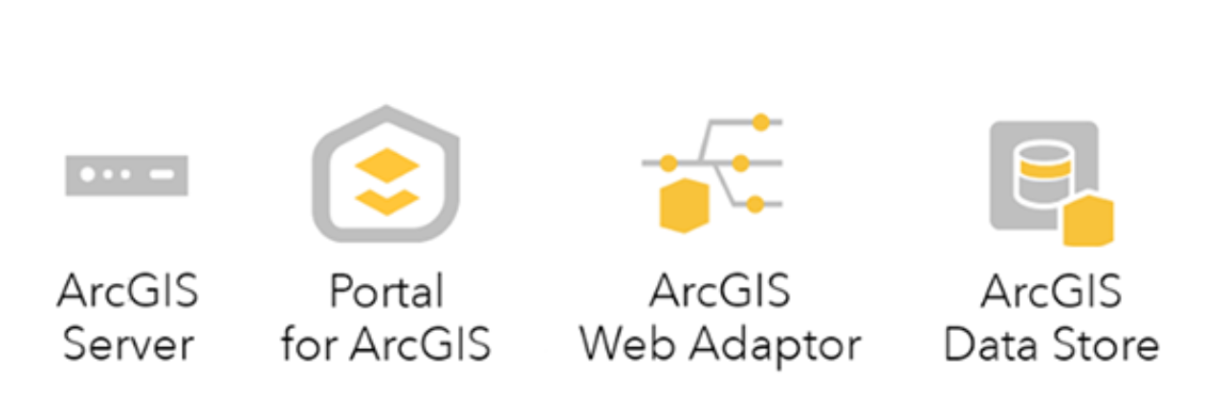
ArcGIS Enterprise

Slide 4


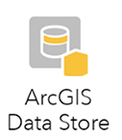
What is the Data Store?
A spatially-enabled Object-relational DBMS (postgreSQL is default)
Stores Data (it is named the Data Store) and helps serve these data to clients via a network
Notes:
Is SDE a database? Does SDE store data or just manage data that is stored elsewhere?

Slide 5
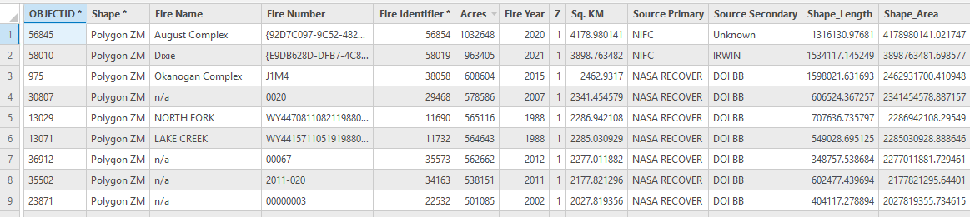
Its All Just Data
As far as PostgreSQL (or any ORDBMS) is concerned, our point, line, or polygon feature classes are no different from what Esri calls “stand-alone table”
Why?
  Let’s look at the attribute table for a polygon feature class

Slide 6
Differentiation
What differentiates a feature class from a stand-alone table?
  The SHAPE field (recall inheritance from the Feature CLASS in the ArcObjects framework)
  Area and Length fields are topologically derived from the SHAPE field
What is the SHAPE field (really!)
  It is a field (attribute) storing LOB data
  This may seem special to us, but its just another DATA TYPE

Slide 7
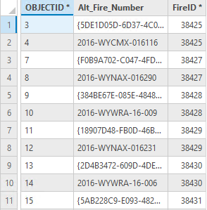
So These are Really the Same
To an ORDBMS, yes!

Slide 8
Why use ArcGIS Enterprise?
Advantages:
  Enable versioning to prevent data loss or degraded data integrity
  Centralize data management
  Make the most current geospatial data is available always
=
Notes:
Define enterprise?

Slide 9
Why? (cont’d)
Disadvantages
  Data management role
  RDBMS administration role
  Capital expenditure
Notes:
Cost: Return on Investment? Unknown now

Slide 10
To Use Enterprise…or Not …
What will help make this decision?
  ROI
  TCO
  Is this the correct technology for the problem?
Notes:
Let students brainstorm

Slide 11

ArcGIS Data Structures
ArcGIS
Vector objects
Feature class
Shapefiles
Coverages
Raster objects
Grids
Images
GDB

Slide 12
The GDB
Can store tables, vector feature classes (layers), relationship classes, topology layers, and raster layers
GDB

Slide 13
Layers and Layer Files
All GIS data are considered LAYERs in ArcGIS.
BTW, A LAYER FILE is different than a LAYER.
  It is a file you save in ArcGIS Pro to retain customized settings and appearance for a LAYER.
  The LAYER FILE refers to the LAYER (feature class, shape file, image, or grid), as well as…
  Provideing instructions regarding visualization/symbology, text/labelling, scale/display thresholds, etc.

Slide 14
The Workspace
ArcView
  Collection of ArcView shape files in a folder
Geodatabase
Notes:
Hold on a minute…what in the world is a workspace?
A workspace is a folder on your workstation where you store your GIS coverages and files. Each workspace needs an Info folder.
You can instruct AI to create a workspace or AI will create a workspace for you when you set your workspace to an existing folder.
How do you do this…simple
type &workspace c:\winnt\profiles\…etc [NOTE THE &]
If you are going to do all this typing it certainly makes sense to use AML’s.
It will also be helpful to use AML’s to set up some routine configurations each time you run AI.
To help you out and get you going I have created two simple AML’s that you should download from the Server and copy to your Personal profile folder. The personal folder will be your ROOT or HOME WORKSPACE.
Your workspace will contain coverages. Coverages differ from themes in that they are a set of files stored in a coverage folder --the name of the coverage-- and the workspace’s info folder.

Slide 15
Geodatabases
Personal pGDB (not supported in ArcGIS Pro)
Mobile GDB
File-based fGDB
Enterprise
  Data Store (formerly known as ArcSDE Personal or ArcSDE Professional)

Slide 16
Mobile Geodatabases
Limitations
  2TB
  Only vector feature classes are actually stored inside the Access database
  Multiple readers allowed but only one editor
  Does not support versioning
  Uses SQLite RDBMS

Slide 17
File-based Geodatabase
fGDB
Stores vector and raster layers in the file/folder structure.
Limitations
  Multi-user (max = 10)
  1 Editor (no versioning)
  Max size is 1 TB
RDBMS

Slide 18
The GeoPackage
Is a relatively new database for geospatial data based on SQLite
  It is open and platform independent
A GeoPackage database can store:
  Vector features
  Raster imagery
  Stand-alone attribute tables
Supported in ArcGIS but not controlled by Esri

Slide 19

Workgroup Geodatabase
Uses MS SQL Server Express
Limitations
  10 GB
  Supports versioning/replication but only one editor
NOT an enterprise solution but a great way to learn the enterprise workflow

Slide 20

Enterprise Geodatabase
Uses PostgreSQL, DB2, Oracle, SQL Server, and SAP HANA
No software size limits and unlimited number of users
Can accommodate vector and raster data

Slide 21
Given all these differences, there are really many similarities

Slide 22

Geospatial Data Storage
(Vector)
Vector geospatial data are stored as Feature classes
Non-spatial data are stored as stand-alone tables
Relationship classes can be used to connect feature classes and stand-alone tables
Notes:
This schema shows paths for vector data storage as an example.
Effectively, you must know and understand the data is stored as a feature class. It is no longer a coverage or a shape file.
Raster data is also accommodated in SDE.

Slide 23
Geo-spatial Data Storage
(Raster)
Two methods
  Stand-alone raster dataset
  Mosaic Dataset
The Enterprise GDB is not the best solution to store raster GIS data
  Size considerations
  Performance issues
This is because raster data is handled by ArcGIS and not natively by the ORDBMS
Notes:
Stand-alone: Each raster grid/image imported becomes its own raster layer in SDE.
Embedded: Each raster grid/image imported has most of its data stored separately within the RDBMS tables, some parts are stored collectively sort of like a grouping in ArcMap. The data is displayed in one piece. Data returned to the user is the index value for the raster layer (1 (the first one added to the catalog) through n).
Mosaic: All raster grids/images imported are mosaiced together into one piece. The data is stored as one unit and displayed as one unit. Building pyramids and calculating statistics is very important.
The number of “stats” records and pyramids records changes too.
BRAINSTORM BENEFITS AND ADVANTAGES…METHODS VARY FOR DIFFERENT DATA SETS…

Slide 24
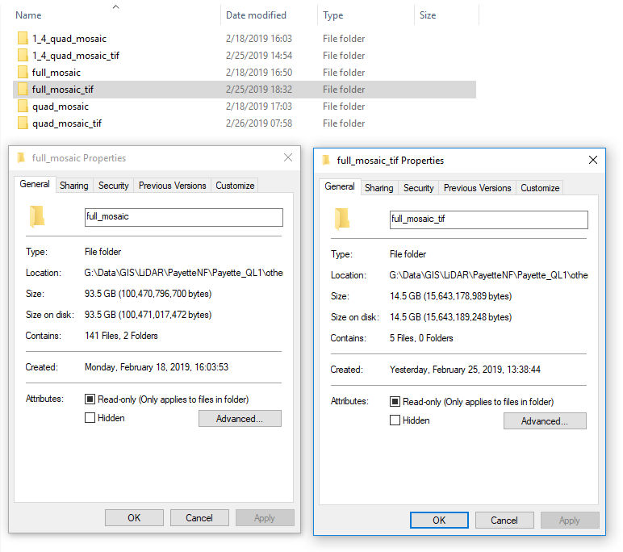
Stand-alone Raster Datasets
Do not store these within a GDB
  Performance is slow
  Consumes a lot of space in the GDB
Notes:
Table spaces are invisible to the user or client.

Slide 25


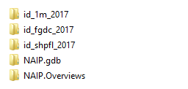
Mosaic Datasets
Fantastic use of the fGDB

Slide 26
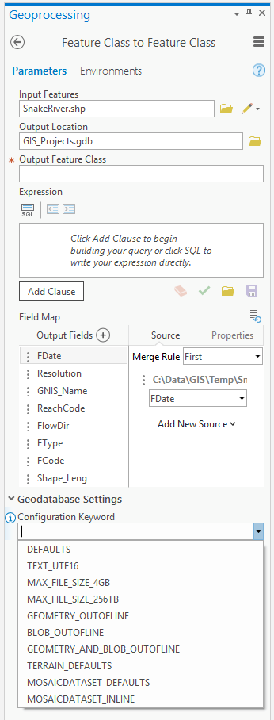
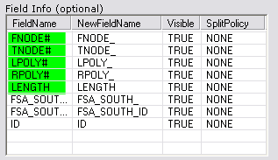
Loading Vector Data into a GDB
PART 1: Feature classes
Notes:
Log into SDE as a manager level. In catalog
Goto SDE, choose import
Do singles…you will see why (field names)

Slide 27
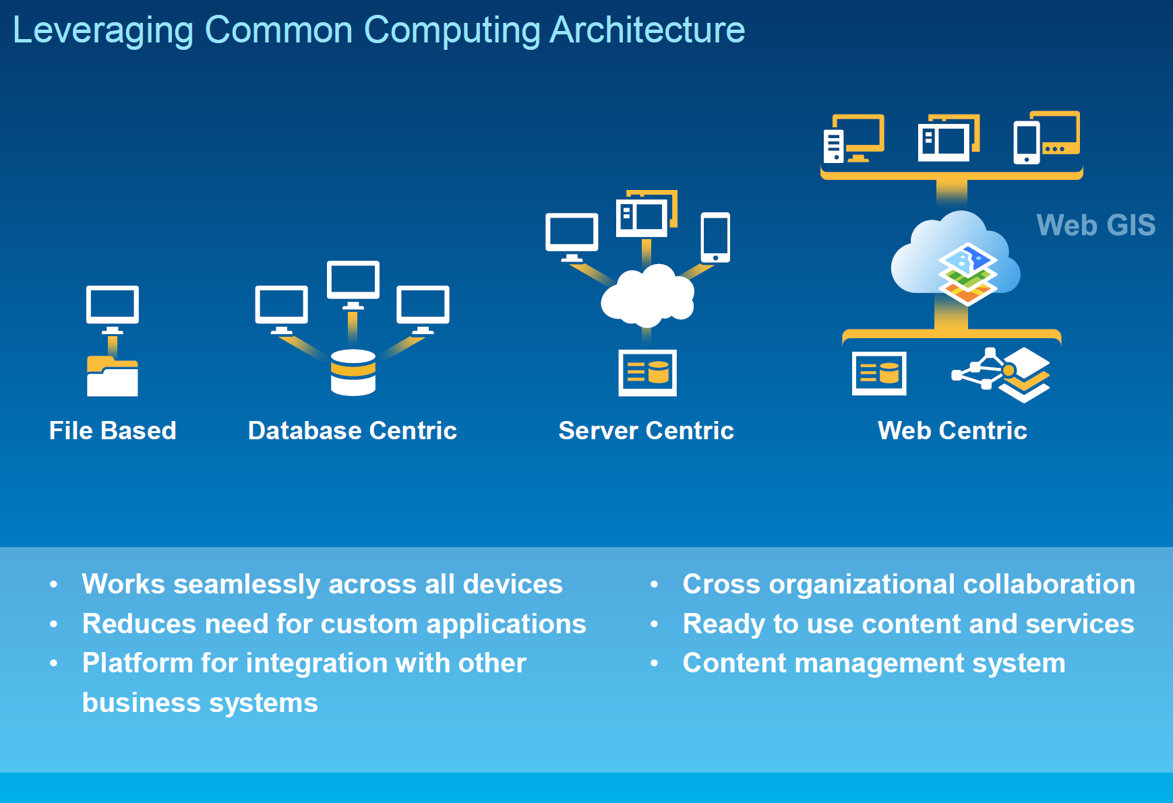
The Future…
Notes:
SDE going away?

Slide 28
Questions…

Slide 29
Geodatabases in an Enterprise Workflow
Keith T. Weber, GISP
GIS Director, ISU
GIS Training and Research Center

Slide 30
Understanding and managing workflow
Presentation and Discussion

Slide 31


Let’s Get Started
GIS is…
  Data-driven
  Powerful
  Dynamic
Adjectives
Notes:
GIS is many things…many adjectives can be used to describe it. For our workshop today however, there is one property of GIS that we will concentrate on and that is “GIS is Dynamic”

Slide 32
GIS Data Life Cycle
Create Data
Edition
Backup
Edit
Validate
Update Metadata
Change Happens!
Notes:
This cycle is not new… it is in fact, old…since the beginning of GIS this is how things were done.
Let’s think about a roads layers. Create by digitizing…that is edition number one when it is done (fix the overshoots and dangles, and populate the database).
Once we recognized that things have changed and our layer is outdated, we plan for how we will fix this. This is very task oriented… so we backup our data (copy it) and then proceed with editing it. Hopefully we validate our edits and update our metadata as well.
Now we have a new edition of the roads layer and all is right with the world.
There is nothing wrong with this cycle. IF the rate at which “change happens” and the demand/expectation for a new edition is not too frequent.
For instance… 1 revolution per year or per quarter is not too bad. But what if the demand and expectation for a new edition…and the need for a need edition requires 1 revolution per week or per day?

Slide 33

The Bottleneck
Distributing the new edition via the network

Slide 34
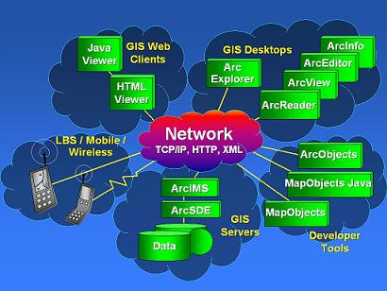
The Solution
Networks and the Internet

Slide 35
A New Problem is Born
“MY” version

Slide 36
GIS Grows Up!
ORDBMS
  Keep the benefits of network connectivity
  Eliminate the problem of “MY” version
  Eliminate the bottleneck
  And, change the cycle of events

Slide 37
GIS Data Life Cycle
Create Data
Edition
Version and/or Replicate
Edit
Validate:
Synchronize or reconcile and post
Update Metadata
Change Happens!
Notes:
Two things have changed:
Wording/terminology: We don’t backup today, instead we version and replicate. We don’t just check things over as our validation, today we also need to synchronize or reconcile and post.
Colors: this is important as it symbolizes a distributed workflow within a team environment… a team that is part of the enterprise.
Blue = manager, orange = technician/specialist, and green = metadata librarian.

Slide 38
Backup vs. Versioning
Backups and archiving are still critical steps for the enterprise.
BUT, not part of the GIS Life Cycle any longer

Slide 39
In the Beginning…
Backups were made in case we really messed up
Edits were made to the original
Copies of the “clean” new edition were distributed

Slide 40
Today…
The original [parent] is versioned [a child is born]
Edits are made to the child, not the parent
“Clean” edits are copied [synchronized or posted] to the parent.

Slide 41
Benefits Of This Approach
Brainstorm!!!
  Minimize downtime
  Processes completed within the RDBMS

Slide 42
The Role of Backups
Data retention and deletion
Legal requirements

Slide 43
GIS Data Life Cycle…Today
Create Data
Edition
Version and/or Replicate
Edit
Validate:
Synchronize or reconcile and post
Update Metadata
Change Happens!
Notes:
This process is enterprise enabled. The manager, technician, and librarian do not have to be in the same office. Indeed, this cycle is “outsourcing-ready”…

Slide 44
Questions/Discussion?

Slide 45
Replication and versioning
Presentation and Discussion

Slide 46
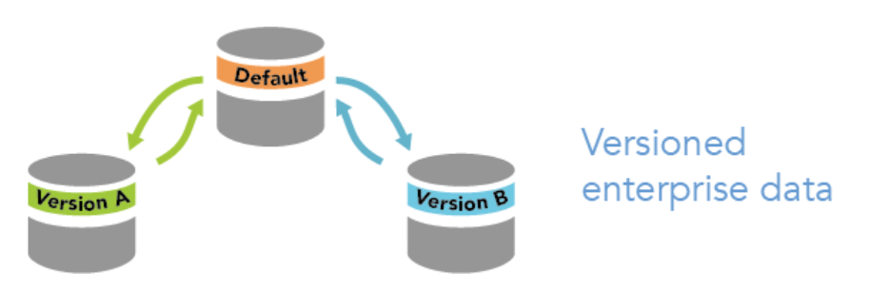
What is Versioning
A framework enabling multiple, simultaneous edits to a feature class in high isolation (i.e., other users in the enterprise cannot see your edits)
It tracks changes to the feature class. It is not a copy of the feature class

Slide 47
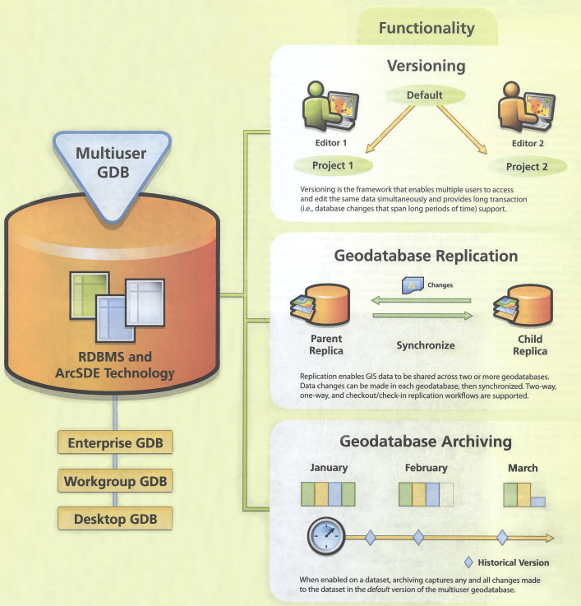
What is Replication?
Duplication
Copying
Mirroring
Synonyms

Slide 48
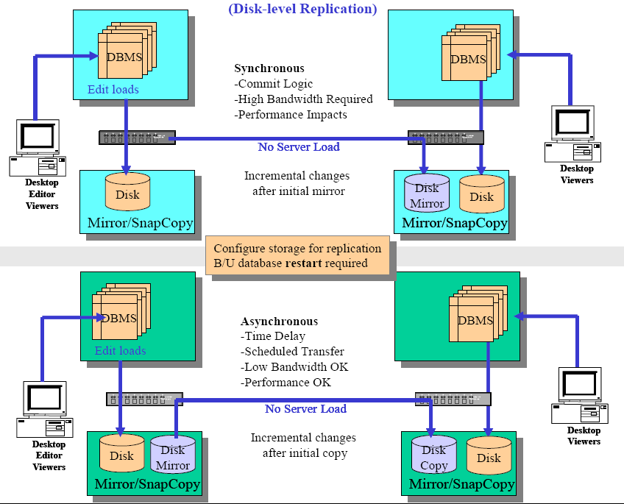
True Replication…
Does not need ArcGIS
Every RDBMS can be replicated natively
However, using ArcGIS to perform the replication
  Is easy
  Better supports GIS workflows

Slide 49
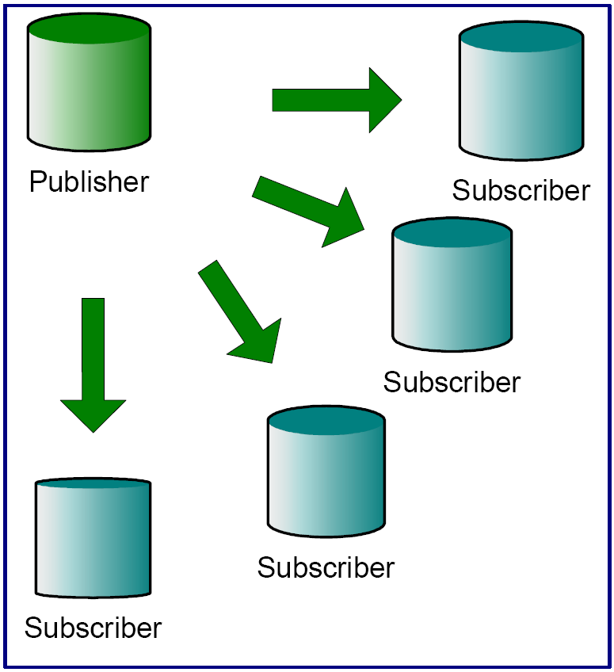
Why Replicate?
Enable disconnected editing for:
  Performance/load balancing
  Network load reduction
  Publishing data to subscribers

Slide 50
Network Load Reduction
The network is a primary bottleneck in the Enterprise

Slide 51
Focus on Versioning…
One database
Parent edition (tables) remains live/usable
Child edition(s) simultaneously edited
Roll-up is seamless

Slide 52
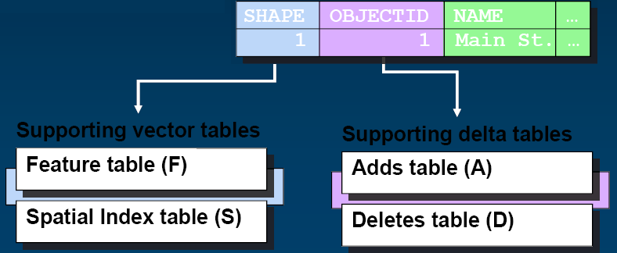
Versioning: Principal Concepts
Edits are stored in “Supporting Tables”
Geographic changes (linework) are stored in Supporting Vector Tables
Attribute changes are stored in Supporting Delta Tables.

Slide 53
Delta Tables
A = Add (insert)
D = Delete
U = Update (delete existing then add)

Slide 54

A Tree is Formed
As versions are created and changes are made, a tree grows
  Q: What kind of tree?
  A: A State Tree

Slide 55


Sort of an Upside-down Tree

Slide 56
The State Tree
Tree Trunk
Default: state 0
Arthur’s Court sub-division
[Another] sub-division
Branches

Slide 57
Multiple Versions
Multiple versions are allowed
  Versions can be based upon location (north edits, south edits), projects (sub-divisions), or other logic decided upon by the GIS Manager.
Batch reconcile and post are supported

Slide 58
The Day of Reconciliation
Arthur’s Court sub-division edits have been completed
  Time to reconcile
  This process looks for conflicts
  Once all conflicts have been resolved…
  Reconciliation is complete

Slide 59
Post
To roll-up the edits back to the “trunk of the state tree” we Post

Slide 60
Two Approaches to Versioning
Classic/traditional versioning where the editor connects directly to the RDBMS and makes edits within the database
Branch versioning where the editor connects via the web and makes edits through a feature services model (not directly connected to the RDBMS)

Slide 61
Under Traditional Versioning
Performance can degrade with active databases
  Workflow itself can generate unnecessary versions
  Delta tables will become large over time
Substantial role for the DB Admin and GIS Manager
  DBMS statistics may need to be refreshed or reviewed by the DB Admin

Slide 62
The Cure
For many of these ArcGIS-centric performance issues is compressing the database
  Moves common rows from delta tables into base tables
  Reduces depth of the state tree by removing states no longer needed

Slide 63
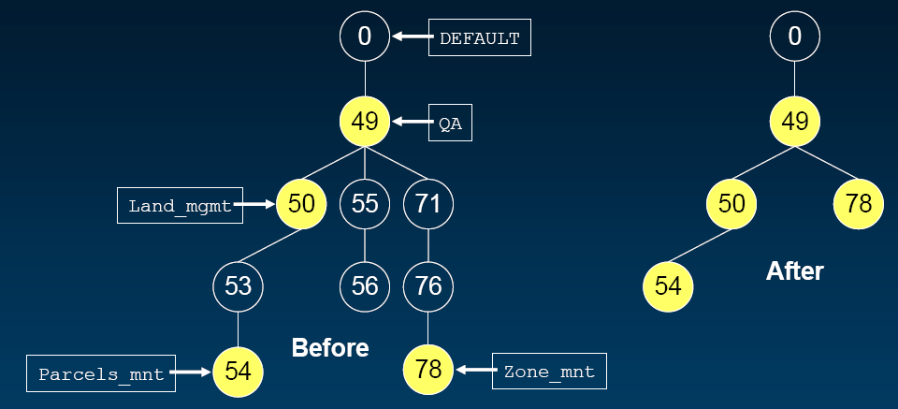
Compression Example
Notes:
Active editing sessions are shown in yellow
Versions with no deltas since last reconcile/post are shown in hollow
GIS Manager compresses, says, I do not need these versions any longer. They are eliminated.

Slide 64
Under Branch Versioning….
DB Admin role is nearly eliminated
  Compression is not needed
All versions are flat, Parent-Child relationships
No “grand-child” versions
You will learn Branch versioning

Slide 65

Key Concepts
Object-Relational databases enable GIS for the Enterprise
The enterprise geodatabase centralizes data management
Understand Enterprise workflow

Slide 66
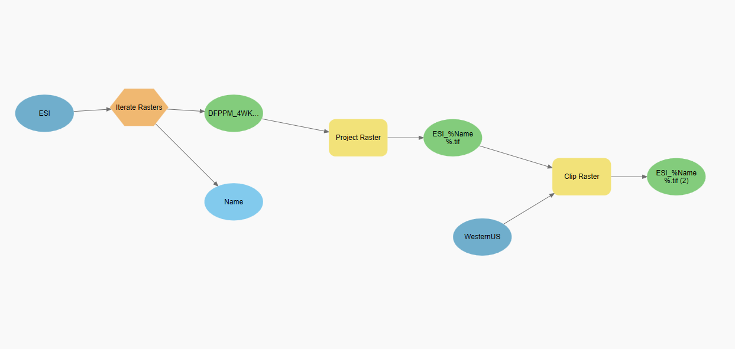
Professional Hints and Tips
Work Smarter not Harder
  Processing lots of files with Model Builder and File Iterator

Slide 67
Questions/Discussion?
Let’s connect to Portal

