Slide 1
Delivering Actionable Information
Keith T. Weber, GISP
ISU GIS Director
GIS Training and Research Center

Slide 2
The Need for Actionable Information

Slide 3
End-users, Customers, Stakeholders, Clients and Decision-Makers
AKA- Our Consumer
GIS is a fantastic decision-support tool
We support our Consumer
Yet, our consumer is often
Drowning in Data…Thirsting for Information

Slide 4
Semantics
Consumer
Data and Information
Is it the same thing?

Slide 5
The Data to Wisdom Pathway

Slide 6
To Put it Another Way

Slide 7
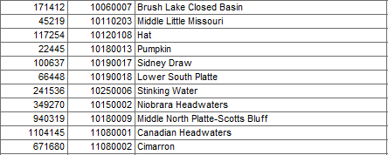
What is?
Data

Slide 8
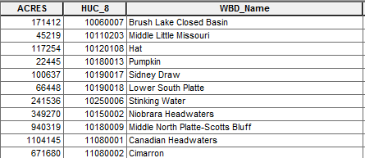
What is?
Information
Data in Context
Data that is Meaningful to you
Data is transformed into Infomation

Slide 9
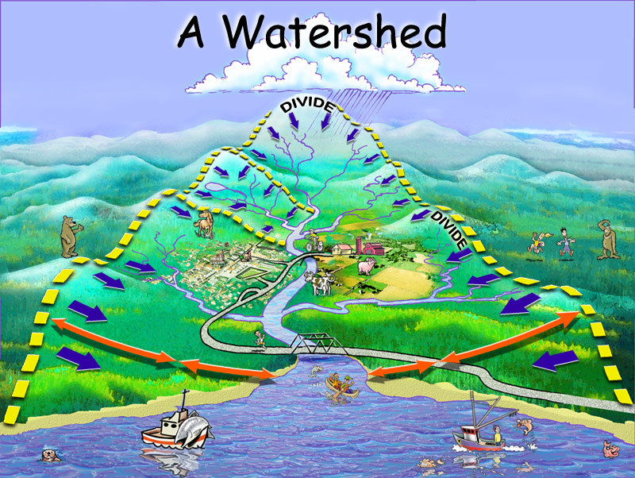
What is?
Knowledge
Context
Meaningful
Speaks to you
Part of your paradigm, your skillset

Slide 10
What is?
Wisdom
Context
Meaningful
Speaks to you
Part of your paradigm
Appropriate use or application of knowledge

Slide 11
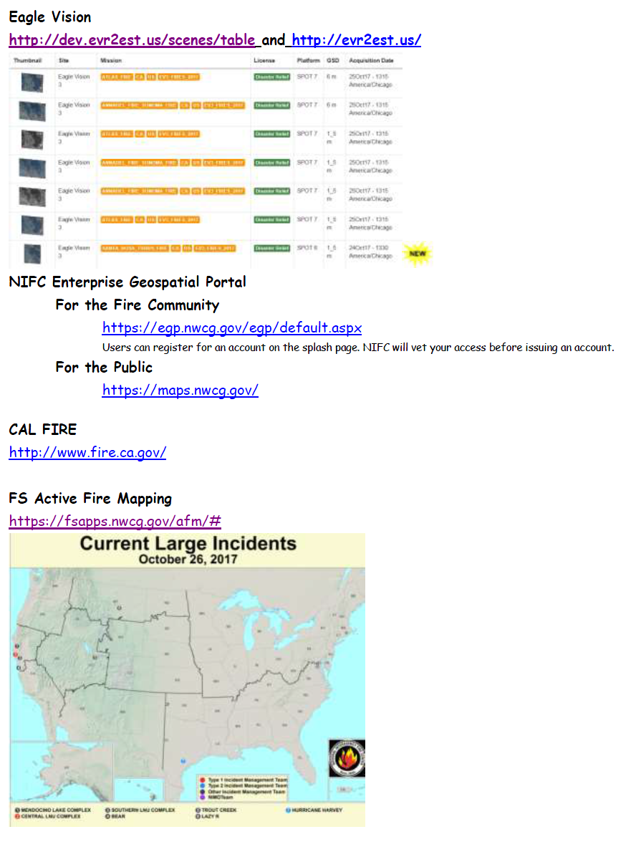
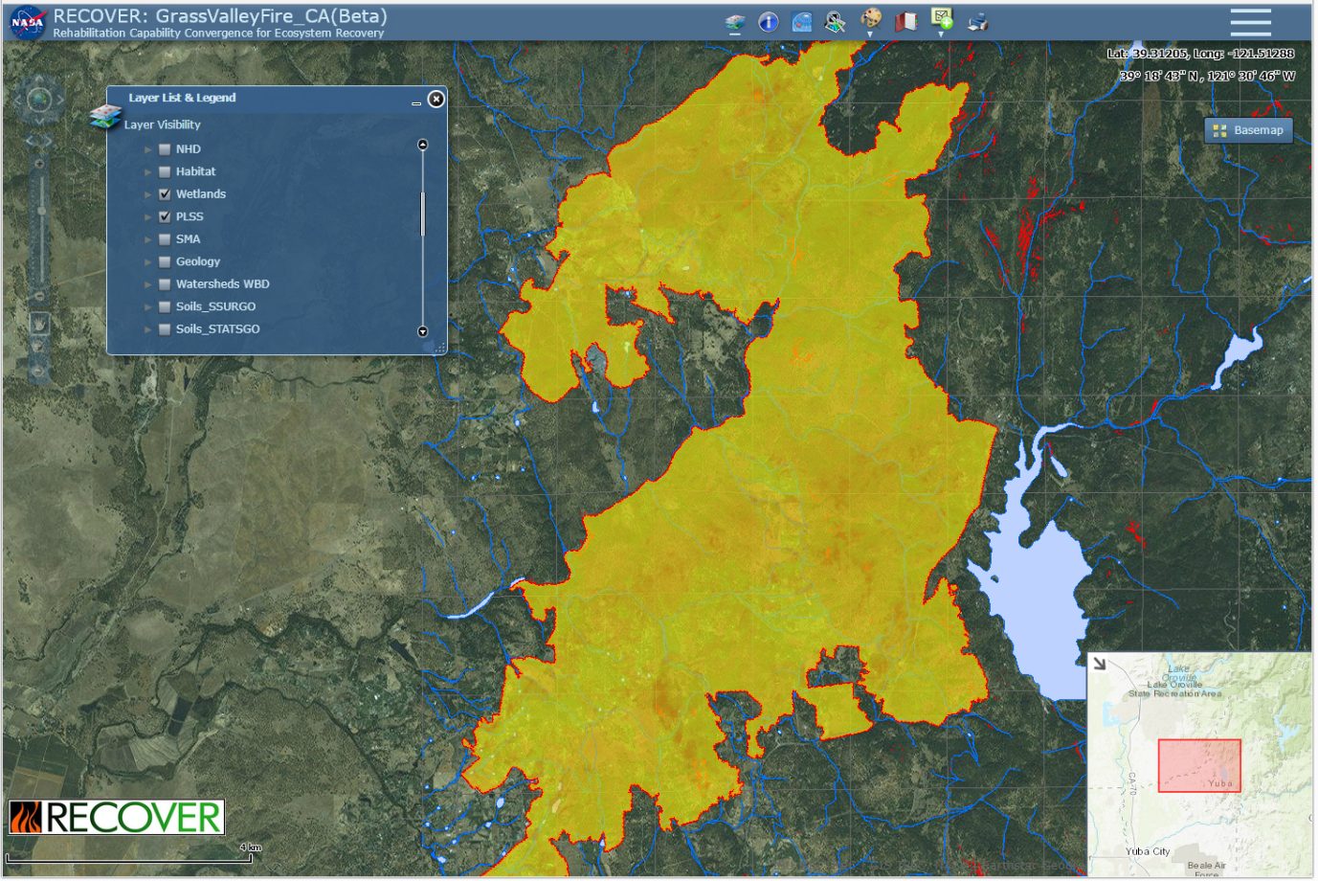
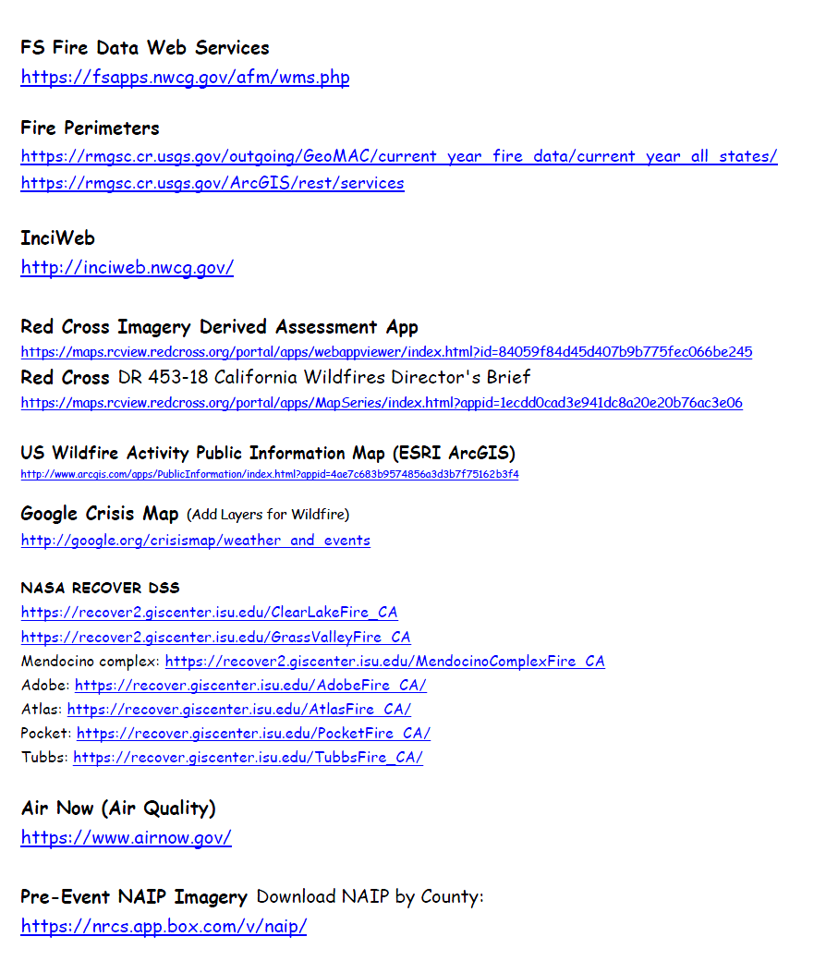
Are you Delivering Data or Information?

Slide 12
Spatial Data Science

Slide 13
Processing Data Does Not Create Information
Visualization, spatial analysis, etc. creates more data
These data tend to be more refined
But the output is still data!

Slide 14
It’s about Communication
How do we communicate with geospatial data?
First, we need data
- Ideally from reliable and/or authoritative sources
- Visualization using standardized or accepted symbology
- Regardless of how you feel about it cartographically
Consider generalization or reclassification
- Principles of cartography
- High, medium, or low instead of 0-10000
- Using meaningful values and words
What does this mean?

Slide 15
It’s about Communication (cont’d)
Use meaningful units
Acres instead of the number of pixels
Miles instead of meters
“Sagebrush-steppe” instead of code 4622

Slide 16
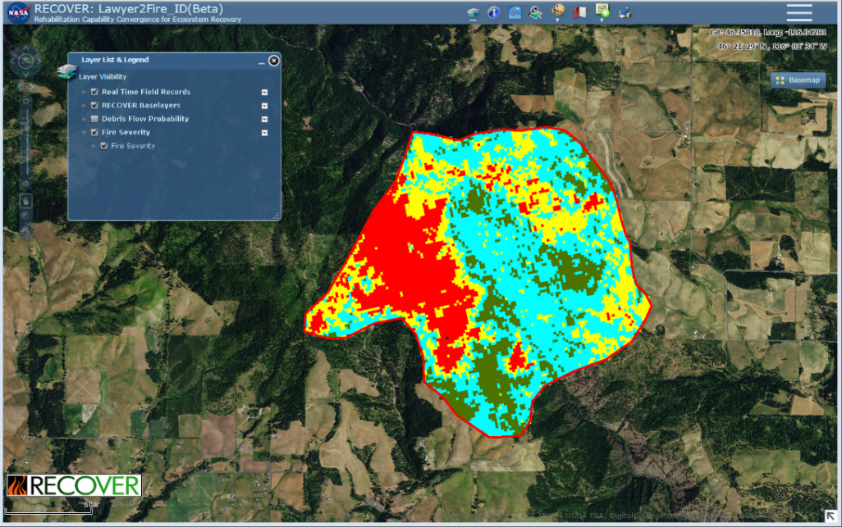
An Example
Q: How much of the 2015 Widget fire was considered a high severity burn?
A: 1,968 pixels
A: 1,771,200 m² (1,968 30x30 m (900 m²) pixels)
A: 437.673052 acres (be cognizant of significant digits)
A: 437 acres

Slide 17
Is all Information Actionable?
What’s the difference?
Some information may be trivial or tangential
You understand it, but it provides little/nothing toward helping to make a decision
Actionable information is pertinent and applicable
It is information that helps make a decision
Information that can be acted upon

Slide 18
How are Decision Made?
While we (GIS’ers) are not the decision maker
Our actionable information should support wise, well-informed decisions
OODA

Slide 19
Observe, Orient, Decide, and Act

Slide 20
How Are Really Decisions Made?
Does actionable information really drive a well-informed decision process?
Unfortunately NO (not normally)

Slide 21
PPPP

Slide 22
The 4-Ps
Power
Profit
Politics
Pride
BUT, we still need to do our part as scientists

Slide 23
Actionable Information Checklist
Step 1: Identify and understand the consumer.
Step 2: Understand the question!
Step 3: Leverage your strengths
Step 4: Get to know the data
Step 5: Make a great map!
Step 6: Automate
Step 7: Engage in a Team of Teams approach

Slide 24
Understand the Consumer
In some cases, the consumer may be John Q. Public
In other cases, the consumer is a more specific end-user
In still other cases, the consumer is all the above
To make this easy for our learning process, we will identify a specific end-user/consumer

Slide 25
Our Project Scenario
The Widget Wildfire
Problem: Identify post-fire risks
Consumer: Land managers/emergency managers at the local, state, and federal levels

Slide 26
Notes:
Poll Title: Do not modify the notes in this section to avoid tampering with the Poll Everywhere activity. More info at polleverywhere.com/support Let's craft a meaningful question https://www.polleverywhere.com/discourses/aX68Nk6ZyGFroCcLRt7C0

Slide 27
Another Step in the Checklist
When you have finished spatial analysis and are ready to deliver results…
Ask yourself:
How can I explain this, so the results can immediately support sound decisions?
How can I best communicate my results?
How can I help turn these data into actionable information?
https://www.directionsmag.com/article/1143

Slide 28
Applied Actionable Information
Engage in a team of teams approach
This is actually quite critical

Slide 29
Transforming data into information
Hands-on exercise

Slide 30
Professional Hints and Tips
Calendars
Accept or decline invitations
This is professional etiquette and acts as an RSVP for meeting organizers (i.e., they do not need to follow up)
Be on time for all meetings
Better yet, be a few minutes early

Slide 31
Questions/Discussion?

