Slide 1
Emerging Artificial Intelligence
Keith T. Weber, GISP
GIS Director, ISU
GIS Training and Research Center
webekeit@isu.edu

Slide 2
What Types of AI Exist Today?
Narrow AI
Also known as Weak AI and Artificial Narrow Intelligence (ANI)
Exists today
Performs a single (narrow) task very fast
General AI
Artificial General Intelligence (AGI)
Currently theoretical
Super AI
Theoretical/sci-fi (may never exist)

Slide 3
Types of Narrow AI (ANI)
Image recognition
Identify objects and features
Facial recognition
Voice assistants
Siri and Alexa
Generative AI
Chat Bots
ChatGPT (Generative Pre-trained Transformer)
Use Large Language Models (LLM)

Slide 4

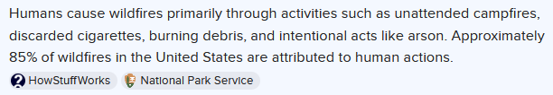
Mistakes are Common
What is the primary ignition source of wildfires?
Do humans cause the majority of wildfires?

Slide 5

AI Hallucinations
Mistakes or incorrect output

Slide 6
Is AI New?
One of the earliest Machine Learning algorithms was an Artificial Neural Network (ANN) developed in 1958
The Perceptron developed by psychologist Frank Rosenblatt
Numerous advances and applications in image recognition (classification) were developed in the 1990’s
Multi-layer Perceptron (MLP)
Convolution Neural Network (CNN) Deep Learning
Classification Tree and Decision Forests are types of Machine Learning

Slide 7
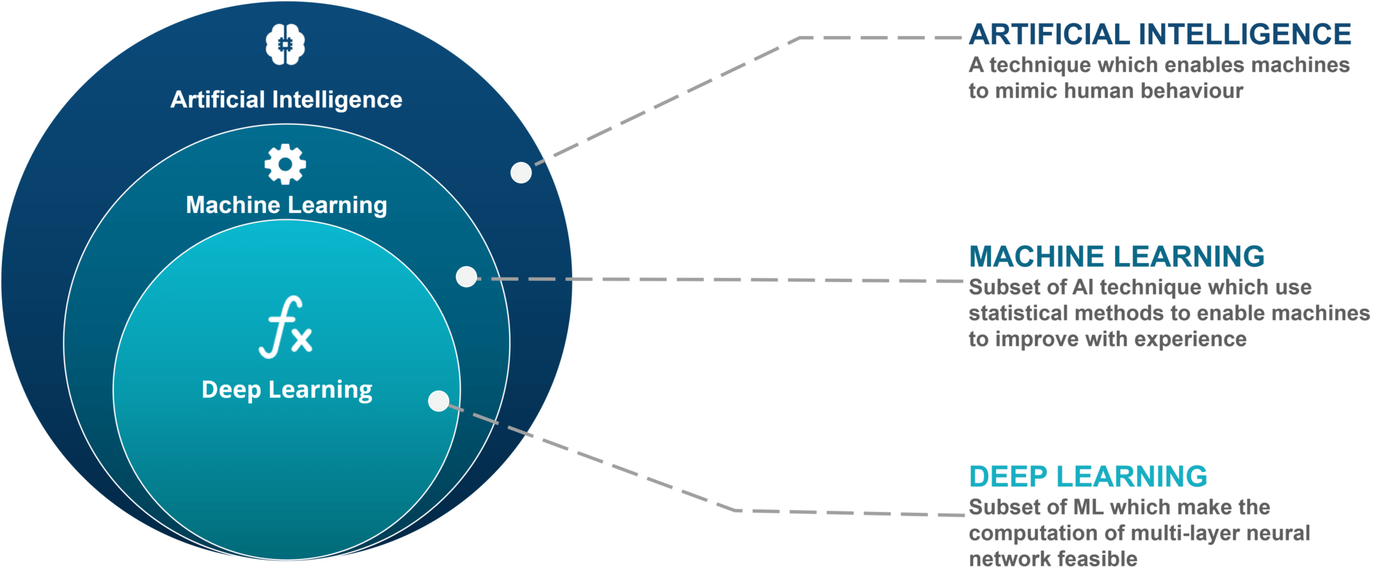
AI, Machine Learning, and Deep Learning
Source https://www.edureka.co/blog/wp-content/uploads/2018/03/AI-vs-ML-vs-Deep-Learning.png

Slide 8
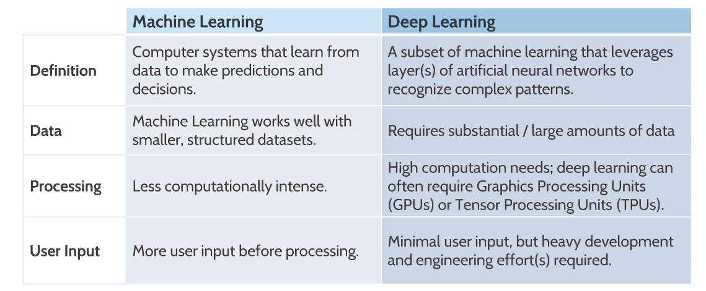
ML & DL
Source GEOTalks 2025

Slide 9
Remote Sensing Image Classification
Common application in GIS
Originally Unsupervised Classifiers were used
Clustering based on spectral signatures
Later, single iteration Supervised Classifications were developed
Pixels that match the mean value of a training pixel were considered the same class as the training pixel
Minimum Distance to Mean, Parallelepiped, and Maximum Likelihood

Slide 10
Today…
More advanced ML and DL (AI (ANI)) classifiers are the norm
Can create accurate models of the real world
Importance of good training data
Independent Validation is very important
Beware over-fitted models

Slide 11
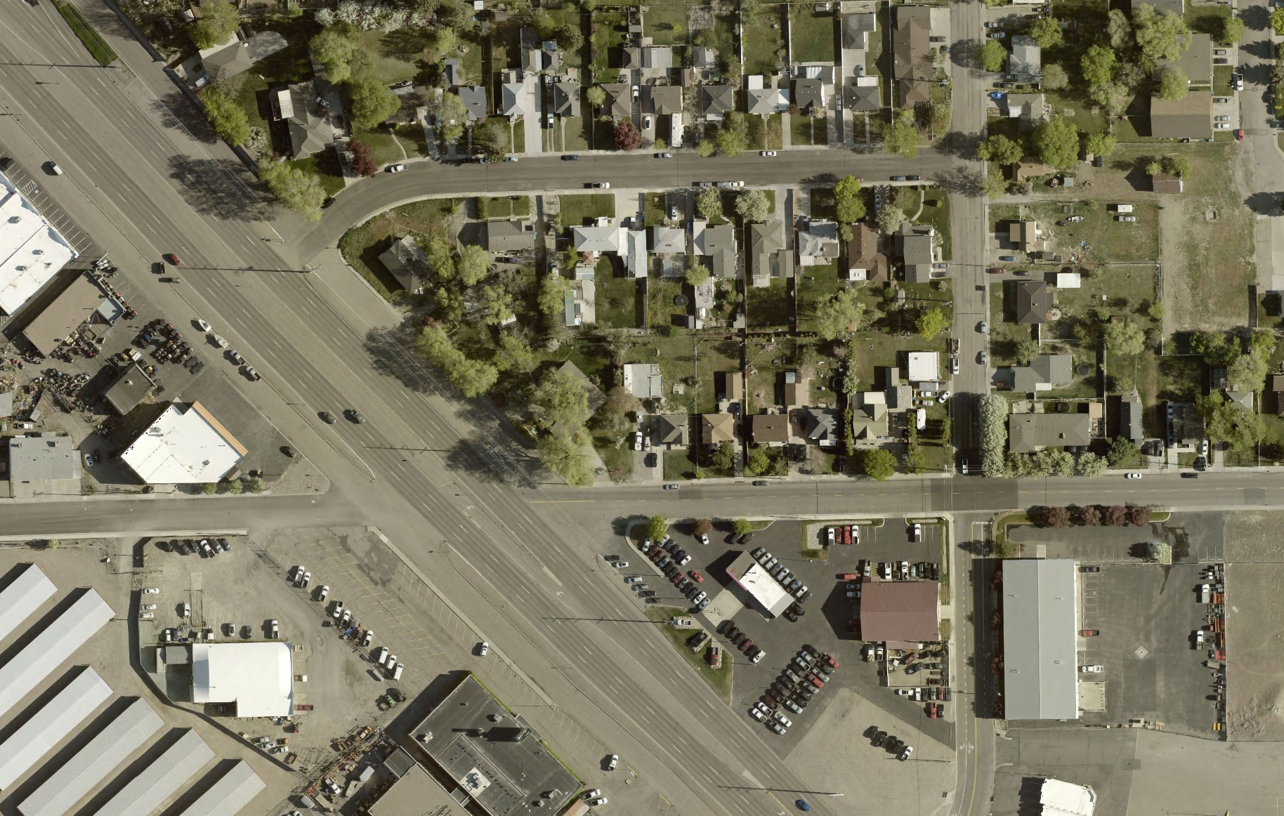
Beyond Classification
Object/feature extraction
Sidewalks
Utility poles
Structures
Tree canopies

Slide 12
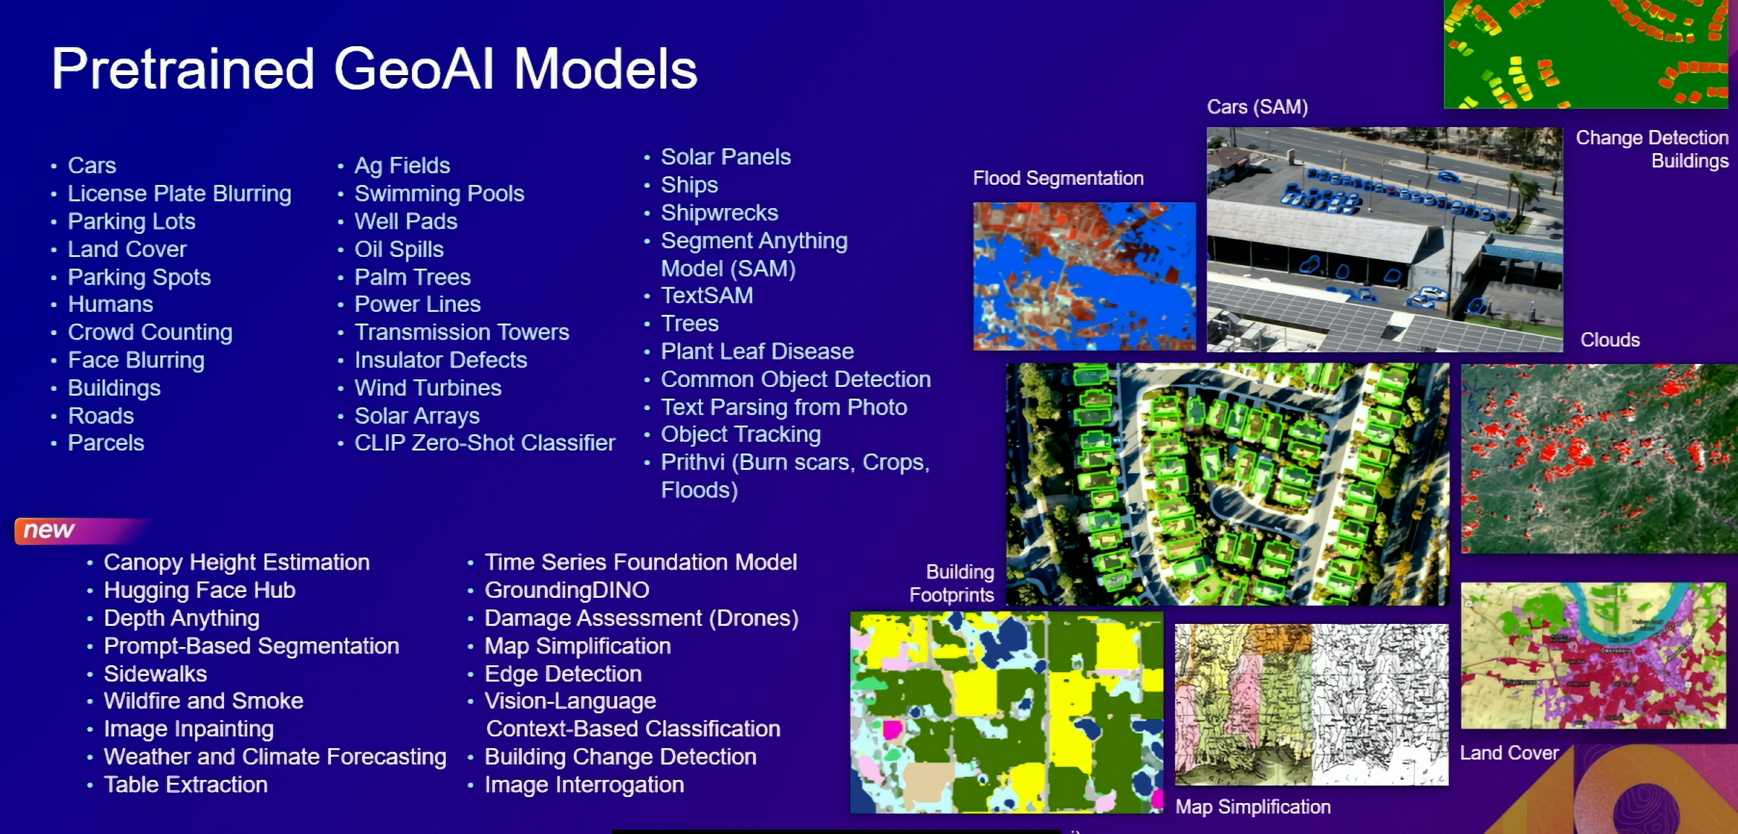
Pre-Trained AI Models for ArcGIS Pro

Slide 13
AI Concerns and Ethics
Use Cases
Privacy fence
County assessors
Energy consumption (ROI?)
Bill of Rights and the Fourth amendment
Patriot Act of 2001
Gorgon Stare and Wide Area Motion Imagery (WAMI)

Slide 14
Rise of Palantir
Began by Peter Thiel (PayPal) in 2003
Three primary components
Foundry (data mining, analytics, and logistics commercially provided as SaaS)
Gotham (government users intelligence, surveillance, etc.)
Apollo (real-time updates and platform management)
Integrated and connected with their AIP
Growing rapidly (e.g., $10B US Army Contract July 2025)

Slide 15
In My Lifetime
I warned others about it, but never thought it would happen in my lifetime…

Slide 16

Key Concepts
AI is an emerging and rapidly advancing technology
Today, narrow AI (ANI) is the primary focus
Numerous spatial applications
Ethical considerations must not be overlooked

Slide 17

Questions?

