Slide 1
SQL, SSQL, and
GIS Data Architecture
IT4GIS
Keith T. Weber, GISP
GIS Director
ISU-GIS Training and Research Center

Slide 2
Today’s Road Map
We will be making some connections
This presentation/discussion focuses on Spatial SQL or SSQL
In this week’s exercise you will revisit some GIS fundamentals
  Data Structure (vector and raster)
  Objects in a Geodatabase
  Topology

Slide 3
Definitions to get started
SQL = Structured Query Language
SSQL = Spatial SQL
GPL = Graphical Presentation Language

Slide 4
SQL- A Review
SQL is a simple language used to query (question) an ODBC-compliant database and retrieve data.
  SQL is not simple or standard
  S = structured
Notes:
ODBC = open database connectivity

Slide 5
Structure
The most basic SQL statement is:
  SELECT * from database.table
Let’s dissect this statement
  SELECT is the command
  * is a wildcard = i.e., everything and anything
  Database.table is the target of the query
Notes:
The * is where we enumerate the attributes or fields we want to have returned to us. In this case we want to see all fields.

Slide 6
A Little More…
The previous SQL statement selected everything from a table
But, how do we select only a portion of a table?
  The WHERE CLAUSE
Notes:
REVIEW SLIDE THEN…
In the previous SQL statement, since we did not use a WHERE CLAUSE all records were retrieved.

Slide 7
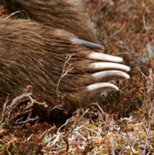
WHERE CLAUSE
WHERE conditional operator
For example:
  SELECT * from database.table WHERE CITY_NAME = ‘Pocatello’

Slide 8
Types of Conditional Ops
Simple (as in the previous example)
Compound
  Let’s say we want to select and work with all records describing Pocatello and Blackfoot
We could select and work with them individually using two discrete Simple statements or use Conditional operators in a Compound Expression

Slide 9
Combining Statements using Conditional Operator Expressions
Instead of:
  SELECT * from database.table WHERE
  CITY_NAME = ‘Pocatello’
  …do some work, and then
  SELECT * from database.table WHERE
  CITY_NAME = ‘Blackfoot’
  …do some more work

Slide 10
We Can Use…
A Compound expression combining two or more simple expressions using either:
  AND
  OR
In our example, which shall we use?
Notes:
The AND operator retrieves a record if ALL conditions listed are true.
The OR operator retrieves a record if ANY of the conditions listed are true.

Slide 11
OR
SELECT * from database.table WHERE
CITY_NAME = ‘Pocatello’
OR
CITY_NAME = ‘Blackfoot’
Notes:
Notice, that both expressions must be complete and able to “stand-alone”…we cannot write CITY_NAME = ‘Pocatello’ OR ‘Blackfoot’ since the second expression (‘Blackfoot’) is incomplete…it is not a well formed conditional operator expression.

Slide 12
Why OR?
Before a record (entity) is returned as a result of a query, the record must satisfy EACH WHERE clause if AND is used.
When OR is used, a record must satisfy only one of the WHERE clauses.

Slide 13
This is SQL
What is SSQL?
  Spatial Structured Query Language
  Or SQL for Spatially-enabled relational databases (i.e., object-relational databases)
    Informix
    Oracle
    IBM DB2
    MS SQL Server
    PostGreSQL
    SQLite (GeoPackage)

Slide 14
An Example
SELECT residence.geometry
FROM residence
WHERE Type = ‘single family’
What is different about this expression?
residence.geometry

Slide 15
Why is *.geometry important?
Until now, we have been returning all fields
  (SELECT * FROM…)
*.geometry returns the geographic feature(s) as objects
SSQL is used to select the geometry (.geometry) of the TABLE of interest (residence) from a spatially-enabled object-relational database

Slide 16
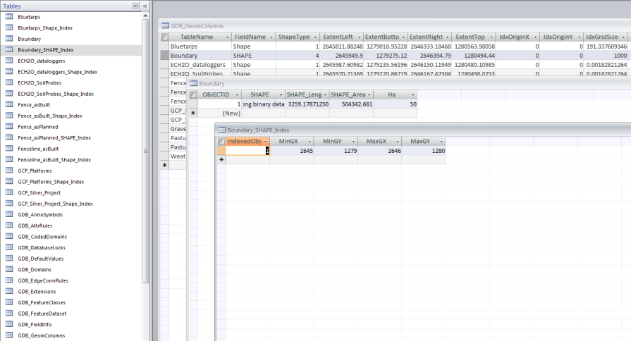
GIS Layers are Tables?
Data type for Geometry
Spatial Grid Extent
Notes:
This is the contents of a GDB in MS Access.

Slide 17
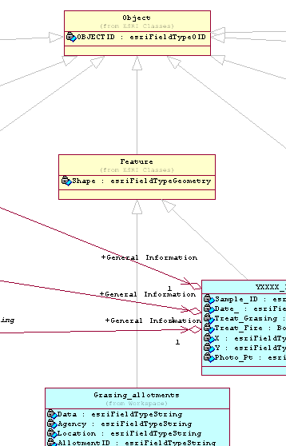
Object Relational
OBJECTID inherited from Object class
SHAPE inherited from a class called Feature
This could be “Boundary””

Slide 18
Geometry Data Type
We have talked a lot about the data types used to store traditional attributes (e.g., long integer, text, etc.)
Recall, an ORDBMS can store OBJECTS natively
What data type is used to store OBJECTS?

Slide 19
Speaking of Geometry
GIS data is all about geometry
  Vector data is based on Cartesian Coordinates (named for René Descartes)
  However, GIS is not Geometric Information Systems, but Geographic
  Vector data are points, lines, and polygons

Slide 20
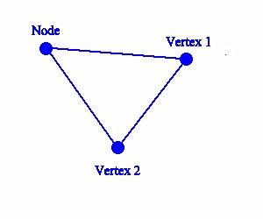
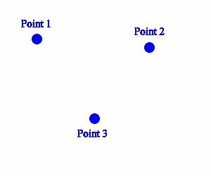
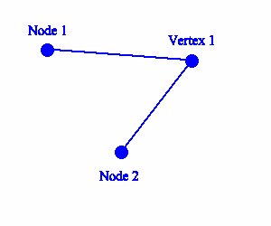
Points, Lines, and Polygons
Understanding the fundamentals of data architecture is critical to being an effective GIS Analyst

Slide 21
How Are These Different?
Besides the names used to describe these (points, lines, polygons, node, vertex), how does point layer fundamentally differ from a polygon layer?
  Think about topology
  Think about code/instruction to draw these geometries

Slide 22
Raster Data (AKA, imagery)
Based on picture (pix) elements (pixels)
  All pixels (cells) have the exact same dimension (X Y)
Each pixel is discrete and identified by a single numeric value (no text)
Raster data can be:
  Boolean (true (1), false (0))
  Categorical (1 = water, 2 = grassland, 3 = forest)
  Continuous (e.g., satellite imagery, elevation data)
All raster layers are rectangular in shape

Slide 23
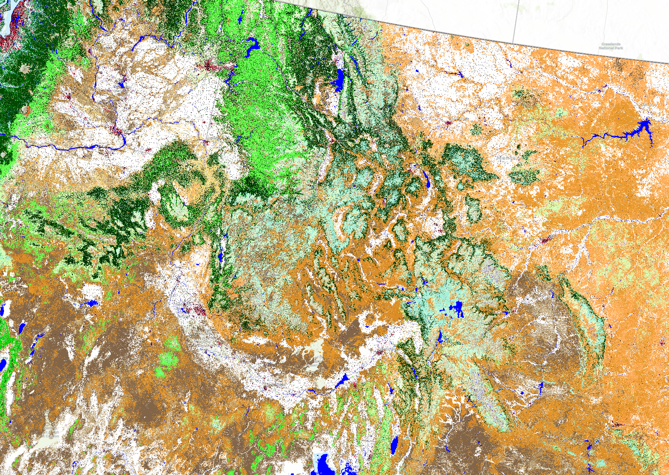
No Topology
We can see patches of pixels in the same land cover class
GIS (the computer software) “sees” individual pixels

Slide 24
NoData Pixels
Mathematically, NoData values are important to understand

Slide 25
Any Image Can Be Georectified
How?
Create a World File
  TFW = TIFF World File
Raster layers are drawn beginning in the upper left corner of the image
10.0000000000
0.0000000000
0.0000000000
-10.0000000000
-2354936.2630753890
3165585.7730424833

Slide 26

Key Concepts
SQL is highly structured
Spatial SQL builds upon SQL but remains within the same general framework
SSQL requires an object relational, spatially-enabled database
The *.geometry field is queried to return features…
  Objects are stored in the table as LOB data (along with other attributes)
Data architecture is important!

Slide 27
Professional Hints and Tips
Work Smarter not Harder
  Open DIR.txt in Excel and extract a list of file names

Slide 28
Questions?

