Slide 1
Introduction to Enterprise
Databases
IT4GIS
Keith T. Weber, GISP
GIS Director
ISU-GIS Training and Research Center

Slide 2
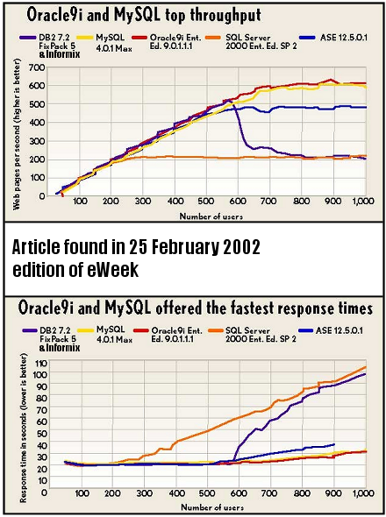
Concurrent Clients
GIS for the Enterprise
  Focus on current/near term concurrent clients

Slide 3
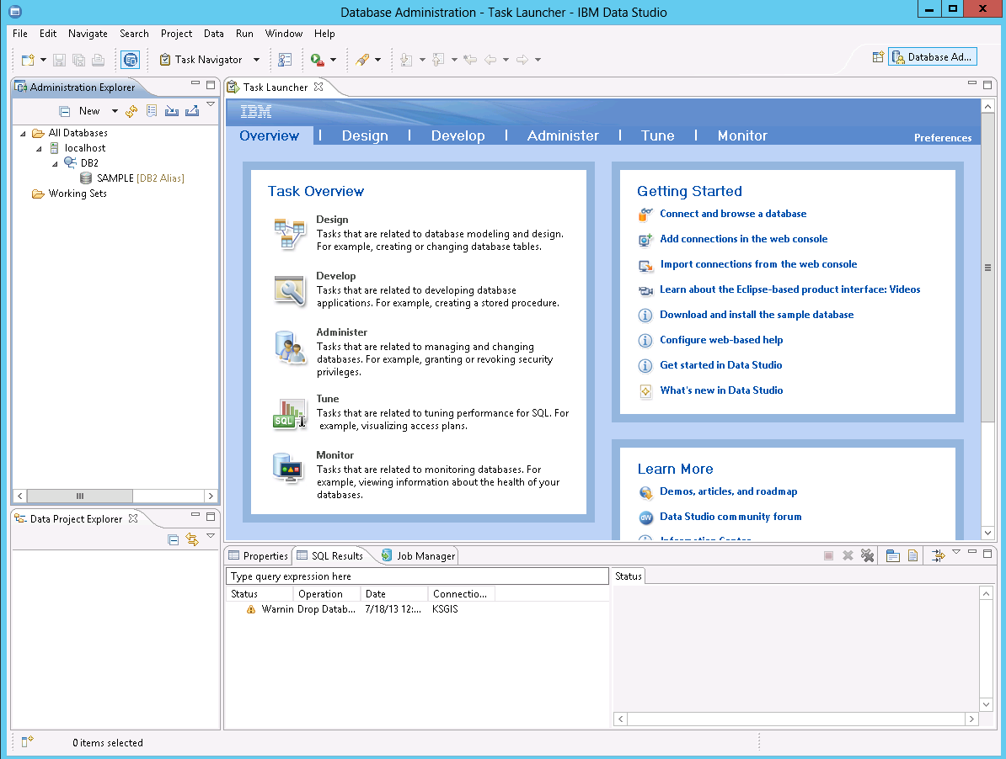
Database Administration (e.g., IBM DB2)
GUI based database administration
Alternatively, command prompt can be used.
Do you know what the command prompt is?

Slide 4
Creating Databases/tables
A database can be a new instance of the RDBMS running on a server
Ensure no instance name is the same as a service name.
How do you check this?
Notes:
How do you check services?
Open services file with NOTEPAD, found in OS folder, under sys32/drivers/etc

Slide 5
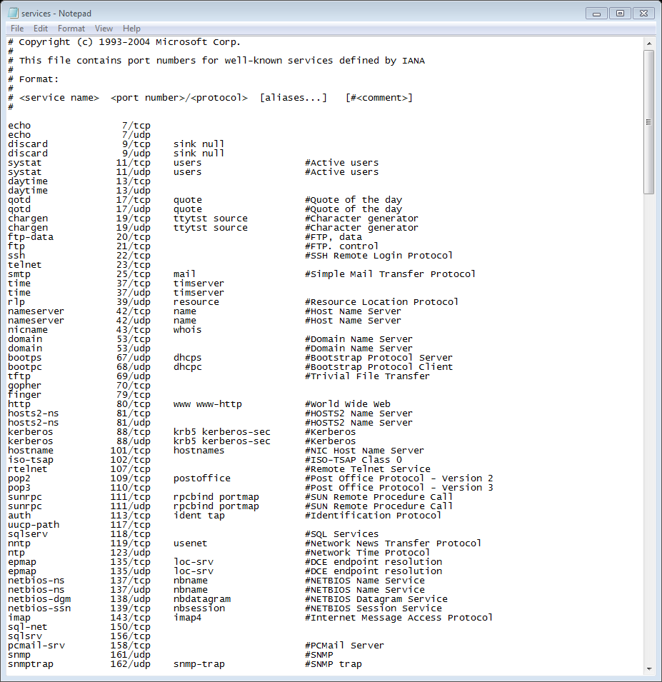
Checking Service Names
C:\Windows\System32\drivers\etc

Slide 6
Unique Features of an Enterprise Database
Pre-fetch
Buffer pools
Table data pages
Pre-fetched into the buffer pool?
Notes:
What is pre-fetch size?
Advance reading of data pages to minimize repeated IO traffic
Buffer pools:
Amt of main memory on the server allocated to the cache table (the table storing pre-fetched data), index, and catalog table pages information.
Table data pages:
The size of each table page. 255 records are stored on each page. All fields (attributes) for each record are included save for the LONG character or LONG special types in which only a pointer or descriptor is stored on the page. Page sizes usually range from 4kb, 8kb, 16kb, to 32kb.
The three specifics greatly effect the efficiency and speed of DB2. To determine table data pages you must know the data types and their storage requirements.

Slide 7
Numeric Data Types
FOR BIT DATA (boolean)
BYTE (0-255)
SMALLINT (-32,768 to 32,767 )
INTEGER (-2,147,483,648 to 2,147,483,647)
FLOAT <n> (2 types)
DOUBLE PRECISION <n_{p},n_{s}>
Notes:
For Bit Data (Boolean)- storage space = 2-bytes
SmallInt (Byte)- storage space = 1 byte
Integer (Int)- storage space = 2-bytes
BigInt (long)- storage space = 4-bytes
Float- Floating point data.
Single precision: A data type that stores single-precision floating-point variables as 32-bit (4-byte) floating-point numbers, ranging in value from -3.402823E38 to -1.401298E-45 for negative values, and 1.401298E-45 to 3.402823E38 for positive values.
Storage space is 4 bytes.
Double precision:A data type that holds double-precision floating-point numbers as 64-bit numbers in the range -1.79769313486232E308 to -4.94065645841247E-324 for negative values; 4.94065645841247E-324 to 1.79769313486232E308 for positive values.
Storage space is 8-byte.
Decimal data type. Parameters are: integer number for precision (0-31), integer number for scale (0-np)
Scale is by power of 10.
A data type that contains decimal numbers scaled by a power of 10. For zero-scaled numbers, that is, numbers with no decimal places, the range is +/-79,228,162,514,264,337,593,543,950,335. For numbers with 28 decimal places the range is +/-7.9228162514264337593543950335. The smallest non-zero number that can be represented as a Decimal is 0.0000000000000000000000000001.
Storage space: numeric storage size of 16 bytes

Slide 8
Data Type Parameters Supported in ArcGIS
FLOAT < n_{p},n_{s} >
  n_{precision(total field} _{length)}
  n_{scale (decimal places)}
  n must be between 1-6 (larger n values need to use DOUBLE)
  n_{p},n_{s} = 5,3 → 26.589 is OK, 256.381 is not
  Five (5) total characters 2 6 . 5 8 9

Slide 9
Parameters (cont’d)
DOUBLE PRECISION <n_{p},n_{s}>
  n_{p =} 7 or more
  n_{s =} 0 or more

Slide 10
Character Data Types
CHARACTER<n>
VARCHAR<n>
Notes:
Character- 1-254
VarChar- varying length, and varying space requirements. 1-32,672
Long VarChar- up to 32,700. User does not specify the max length.

Slide 11
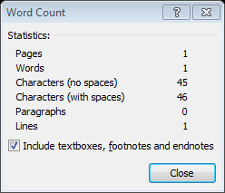
Parameters (cont’d)
CHARACTER<n>
  (AKA, String or Text)
  Example a field named “URL” with n = 46
  “http://giscenter.isu.edu/training/it4gis.htm”

Slide 12
Special Data Types
DATE
TIME
TIMESTAMP

Slide 13
Special Data Types (cont’d)
Stored in special System managed tables
  BLOB<n[K|M|G]>
  CLOB<n[K|M|G]>
  DBCLOB<n[K|M|G]>
  GRAPHIC<n>
  VARGRAPHIC<n>
Notes:
BLOB- Binary large object, maximum length or size is n, expressed as Kilobytes, Megabytes, or Gigabytes). Absolute max is 2GB for each data value.
CLOB- Character large object (same parameters)
DBCLOB- Double byte character large object. (same parameters, however max is now 1GB of double characters)
GRAPHIC- Fixed length graphic string, n = 1-127
VARGRAPHIC- Variable length graphic string- 1-16336
LONG VARGRAPHIC- Varying length graphic string- 1-16,350
DATE- store a date that can be used for date arithmetic
TIME- Store a time that can be used for time arithmetic
TIMESTAMP- timestamp…DB2 generated.
DATALINK- for data stored outside the database. N is the number of characters describing the link
All data type with LONG (character and special) use 32KB page areas each. This includes the LOB’s as well. They are not stored within the data pages however. Just a descriptor or a pointer is stored in the page.

Slide 14
Beware of the 64-bit OBJECTID
The new Esri 64-bit OBJECTID allows practically unlimited number of records in a geodatabase table
HOWEVER, it is not supported by older versions of ArcGIS and is not supported in the shapefile. Thus these data:
  Can only be used in current versions of ArcGIS
  Do NOT support Open GIS
  Cannot be exported for use in other software (QGIS, Idrisi Terrset, etc.)

Slide 15
Table Data Pages
All fields with standard data types for each record are contained within a single data page.
There is a maximum of 255 records stored on each page.
The ART of efficient data modeling is to minimize wasted space on a page while maximizing the proportion of each page written.

Slide 16
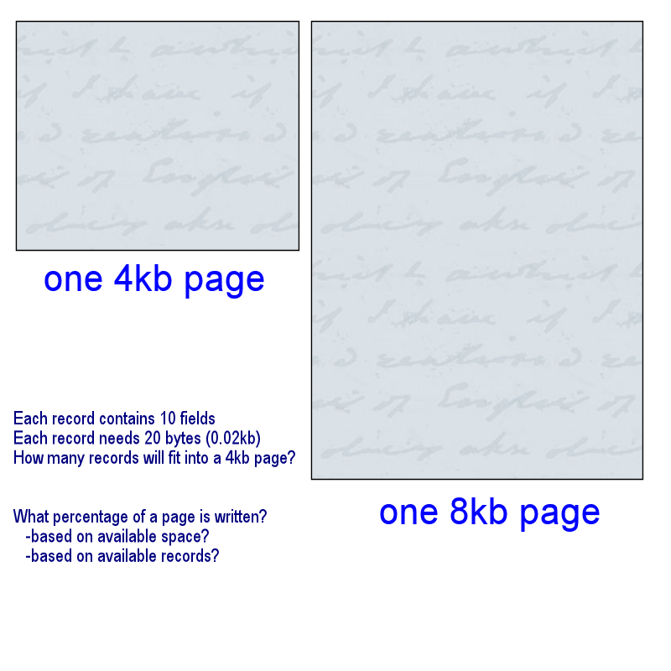
An Example
number of fields | KB per record | page size | KB for 255 records | records at page size | KB USED | KB WASTED | 100 GB TABLE SPACE
10 | 0.02 | 4 | 5.1 | 200 | 4 | 0 | 0 GB WASTED
10 | 0.02 | 8 | 5.1 | 255 | 5.1 | 2.9 | 29 GB WASTED
Notes:
200 records per 4kb page will fit.
255 per 8 kb page.
However, all the available space will not be used that has been allocated. The number of pages does not matter too much (within reason), however the efficiency of each page is important to overall DB performance and overall size → backup → IO etc.
Each table must be evaluated similarly. 4kb will NOT be best for all instances!

Slide 17
Storing Vector Coordinates in a ORDBMS
DB2 Spatial Extender (and other spatially enabled databases) lets you integrate geographic data with your existing business data. It includes:
  Data types such as points, lines, and polygons
  Functions such as area, endpoint, and intersect
  An indexing scheme for spatial data
What about Oracle, MS SQL Server, and PostGreSQL?
Notes:
Details regarding data storage architecture, pre-fetch, and specifically table page space will be addressed when we talk about SDE later in this semester.
However, I will tell you that the spatial extender is an example of object-relational databases (ORDBMS) which we will learn more about in the weeks to come.

Slide 18
Professional Hints and Tips
Working toward a security clearance

Slide 19

Key Concepts
Understand that while data is stored in tables, these tables span TABLE PAGES
Understand what PRE-FETCH and CACHE are…and how they differ.
Understand data types

Slide 20
Questions?

Slide 21
Object-Oriented Design

Slide 22

The Early Days…
Computer programming from the caveman era
Notes:
The first PC’s did not have an OS. They had a BIOS and that is where the user (programmer) interfaced. Programs were small, difficult, and quirky. Because PC’s were not really capable of much (kind of a hobbyists toy…like a ham radio operator) programs were simple things. Like printing text on the screen for someone to read. Adding numbers together (a very expensive calculator which required hours of programming to even enable the calculator to work).
Programs were written sequentially with line numbers.
More complicated programs…those that could NOT be purely sequential because they involved decisions (do you want to add OR subtract) needed to use GOTO statements. Soon the simple sequential programs were bogged down with tons of GOTO’s and the flow was a messy (making them unstable). This programming style was later dubbed spaghetti programming.

Slide 23
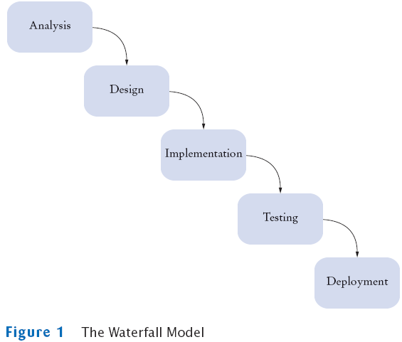
Why…Object-Oriented
A brief history of computer programming…
Early waterfall programming
The concept of encapsulation!
Notes:
As programs grew larger and more complex AND interacted with the OS and other apps more, the need was born to develop programs in re-usable modules or packets. Thereby reducing redundancy and the program footprint, while increasing the computer users learning curve through the development of common/similar tools (open, save, print, etc)

Slide 24
What is?
Fundamentally, we need to know
  What is a CLASS
  What is an OBJECT

Slide 25
What is a CLASS?
A class is a computer construct representing a concept bound in a cohesive package
  Some are concrete (i.e., real world)
    Bank account
    Rental item
    Database item
    Pile
  Others are abstract
    Scanner
    Stream
    Math

Slide 26
Discovering CLASSES
Simple Rule:
  Look for nouns in descriptions
  Obviously not all nouns are classes
  But at least this approach can allow one to create a list of candidate classes

Slide 27
What is an OBJECT
An instance of a CLASS
That contains meaningful data
OBJECTS occupy memory space at runtime
  If not, they are CLASSES
  For example: data type vs. double
Notes:
Data type is a class. It exists as a concept and can be used by programmers and GIS analysts, but does not require computer resources until actually used such as when one declares a field as a double in a database table.

Slide 28

A Little Quiz…
#1 Class or Object?
Dog
Dog is a generalization of Scooby-Doo
Scooby-Doo

Slide 29
A Little Quiz (cont’d)…
#2 Class or Object?
The concept of subclass!
Dog
Dog is a subclass of the Animal class
Animal
Animal is a generalization of Dog
Scooby-Doo

Slide 30
A Little Quiz (cont’d)…
#3 Class or Object?
Animal
The concept of polymorphism!
Bird
Dog

Slide 31
Questions so far…
Notes:
Give tour

Slide 32

Key Points
Many classes already exist and are at our disposal when we design a database
Inheritance is an important concept
  A subclass inherits from its superclass
  i.e., a child inherits from its parent

Slide 33
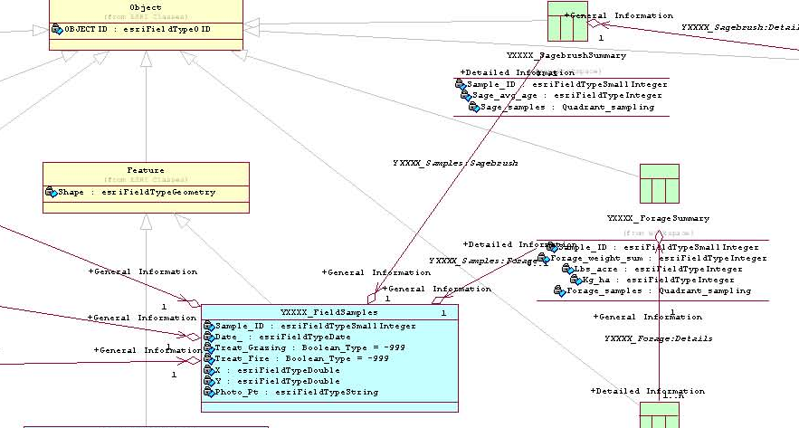
Inheritance in the Geodatabase

Slide 34
Identifying Inheritance
Is-a relationship
Relationship between a more specialized class (subclass) and a generalized class (superclass)
Every…
  Savings account is a bank account
  DVD rental is a rental
  Dog is a mammal
  Parcel is a polygon

Slide 35
INSTANTIATION
CLASS OR OBJECT

Slide 36
Instantiate into an Object
(to make into an instance)
Three features characterize OBJECTS and distinguish OBJECTS from CLASSES:
  Identity: specific attribute (property) settings have been made for the class. This distinguishes it from all other objects.
  State: Describes the data stored in the object WHERE DID THIS COME FROM?
  Behavior: describes the method in the object's interface through which the object can be used (how do we make the dog bark?)
Notes:
Only an instantiated class (an object) can have a state. It is active and dynamic. If something has a state (status) then it is an object, not a class.

Slide 37
Instantiating the Dog CLASS
CLASS (DOG)
Attributes (Properties)
  NAME = Scooby-Doo
  HEIGHT = 36
  WEIGHT = 145
Inheritance?
Scooby-Doo
Notes:
Notice, the properties have a state. This is an object…an instantiation of the dog class.

Slide 38
Key Concepts
Understand the difference between a CLASS and an OBJECT
Understand new terms:
  Encapsulation, polymorphism, superclass, subclass, behavior, attributes, instantiation
Understand why inheritance is an important part of an object-relational database
Notes:
Inheritance, aggregation, dependency

Slide 39
Database Design Concepts and Practices

Slide 40
Basic Steps in Database Design
Understand and document the business’ needs.
  Problem statement
  Business object types
  Business relationships
  Business constraints
Create an ERM
Data and process inventory
Integrity
Populate the database
Notes:
Entity relationship model- a model that graphically expresses the business. It is not a database model.
What are tuple types: they are logical (not physical) datasets. They represent a class with the same meaning, structure, and characteristics. Contains a set of attributes. Relationship types and entity types can be tuple types. During this step, we decide which entity types and rel types will become tuple types. Part of this process includes normalization.

Slide 41
Database Design
Why spend so much time and effort?
  Efficiency (speed, storage)
  Client satisfaction
  Flexibility
  Cost savings realized
Notes:
STUDENTS BRAINSTORM AN ANSWER!

Slide 42
Design Considerations
Basic steps (described earlier)
Data types/Data Modeling
Normalization
With >1 table, relationships must be examined

Slide 43
Relationships
Determine where relationships exist between tables
Determine the type of relationship that exists
  One-to-one
  One-to-many
  Many-to-one
  Many-to-Many
Notes:
Explain how to deal with many to many relations…use an associative table or bridge table containing only the unique_Id’s from both tables. These are fairly rare but messy.

Slide 44
Generic Design Symbology
= Database
= Table

Slide 45
Generic Table Symbology
Parcels
Table name
Divider
List of all attributes stored in this table as they will appear in the table
Parcel_ID
TRS
Value
Zoning

Slide 46
Generic Relationship Symbology
Table A
Draw schema of RDB
Determine relationship fields
Connect
A_ID
Relate_field
Table B
B_ID
Relate_field

Slide 47
Symbolizing Relationship Type
1..1
1..1
One-to-one
One-to-many
Zero?
Table A
1..1
1..M
A_ID
Relate_field
1..1
Table B
B_ID
Relate_field
1..M
Notes:
Talk about one to zero possibility.
1..1 is min/max for that table (source or destination). This is the table’s cardinality/multiplicity.
Possibilities: 0..1, 1..1, 0..M, 1..M

Slide 48
The Relationship Type…
Also known as
  Cardinality (ArcGIS terminology)
  Multiplicity (UML terminology)

Slide 49
Generalized Process
Inception
Elaboration
Construction
Transition
Notes:
Inception is as simple as documenting that “we need a GIS database that will do [x,y,z]”
Elaboration includes planning, needs analysis, user/client analysis, and architectural design. This is similar to graphical implementation in RAD. It is an iterative process. This process can be done in Rational Rose. This is really the business problem statement through ERM and data/process inventory
Construction is the coding process. This is also done in Rational Rose using class diagrams
Transition is when the design package is completed…or a version of it is completed, and delivered to the end-user. This process includes conversion of UML into XML (via XMI), and import into a geodatabase using the ArcGIS Schema wizard.
This workshop will give you an inception scenario as well as basic elaboration (on paper). We will then spend our time in the construction and transition phases.
However, you should understand that inception and elaboration are very important and time consuming. Further, they are indispensable!
Before we proceed further, we will diverge into a simple and fun exercise designed to help us appreciate the elaboration phase. While today’s elaboration will not be used in our geodatabase model, it will serve to demonstrate the importance of the elaboration phase.

Slide 50
Professional Hints and Tips
Getting ready for job interviews
  Social Media
  Dress for success

Slide 51
Questions…
Notes:
Give tour

Slide 52
Your Assignment
Complete the exercise following the README text file in this week’s exercise package
But first, time for another 2-minute Write!

