Slide 1
Understanding Networks
IT4GIS
Keith T. Weber, GISP
GIS Director
ISU-GIS Training and Research Center

Slide 2
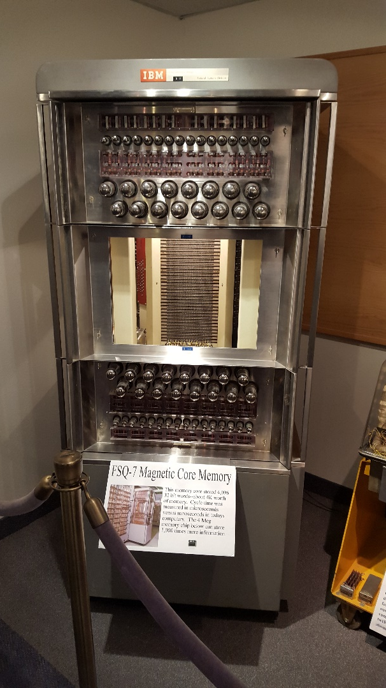
Once Data is Created (saved)
Someone will want a copy (sharing)
  BTW, this entire refrigerator-sized memory bank stored 4KB of data
  That’s 0.000004 GB

Slide 3

Why is Networking Important?
GIS has always been cursed with the need to use large files
GIS’ers have always acted as a community
Sharing is normal

Slide 4
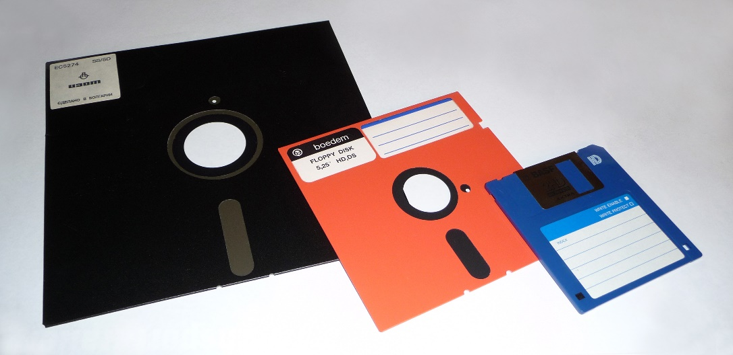
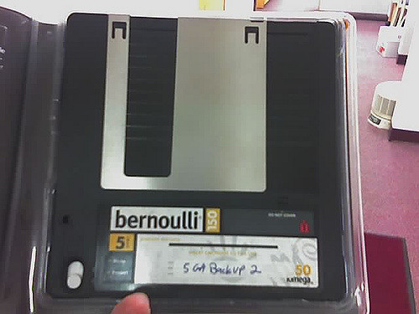
How to Facilitate Sharing…
Floppy disks
Bernoulli disks
Zip disks
Jazz disks

Slide 5
In the beginning…
There were floppy disks
And the “Sneaker Net”

Slide 6
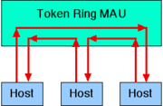
Then along came…
Networks
  Cabling that allowed computers to connect to one another
  Token ring
    Developed by IBM
    Using coaxial cable
  And then…
Notes:
Token ring local area network (LAN) technology was conceived by Olof Söderblom in the late 1960s, then working for IBM. US Patents were awarded in 1981 and Token-Ring was developed and promoted by IBM in the early 1980s and standardized as IEEE 802.5 by the Institute of Electrical and Electronics Engineers. Initially very successful, it went into steep decline after the introduction of 10BASE-T for Ethernet and the EIA/TIA 568 cabling standard in the early 1990s. A fierce marketing effort led by IBM sought to claim better performance and reliability over Ethernet for critical applications due to its deterministic access method, but was no more successful than similar battles in the same era over their Micro Channel architecture. IBM no longer uses or promotes token ring. Madge Networks, a one time competitor to IBM, is now considered to be the market leader in token ring.

Slide 7
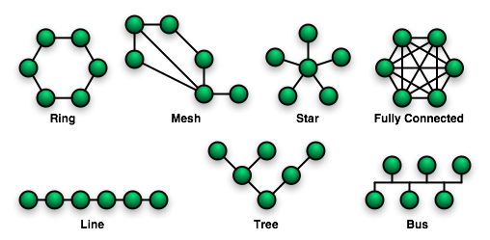
Ethernet
Developed by Xerox
Uses Star-topology
And twisted pair cabling
Notes:
Ethernet is a large, diverse family of frame-based computer networking technologies for local area networks (LANs). The name comes from the physical concept of the ether. It defines a number of wiring and signaling standards for the physical layer, through means of network access at the Media Access Control (MAC)/Data Link Layer, and a common addressing format.
Ethernet has been standardized as IEEE 802.3. Its star-topology, twisted pair wiring form became the most widespread LAN technology in use from the 1990s to the present, largely replacing competing LAN standards such as coaxial cable Ethernet, token ring, FDDI, and ARCNET. In recent years, Wi-Fi, the wireless LAN standardized by IEEE 802.11, has been used in addition to or instead of Ethernet in many installations.
The center of the star is a hub…usually a switch. The switch is then part of a large star where it acts as a node and the hub is a router.

Slide 8
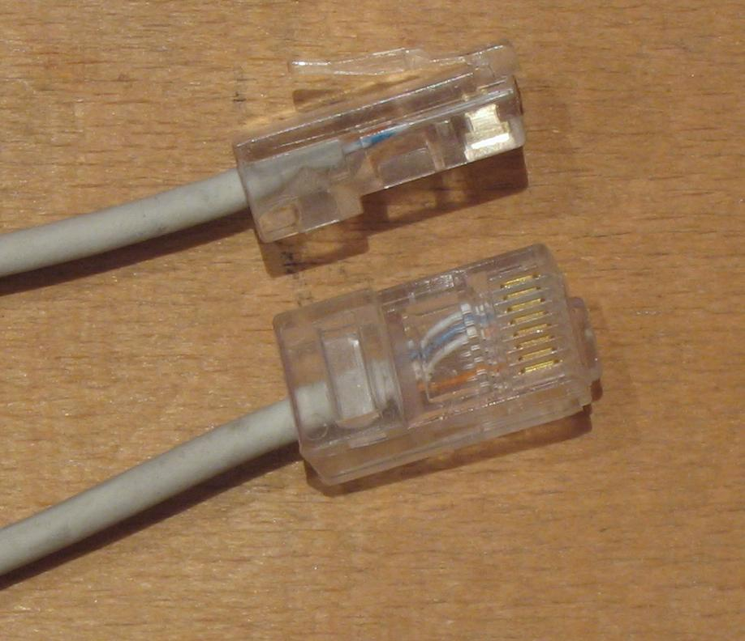
Cabling
Twisted pair cabling can be either unshielded (UTP) or,
Shielded
IT4GIS will focus on UTP
Notes:
This was developed by AT&T, and is essentially glorified telephone line cabling.

Slide 9
Capabilities
Ethernet is described by its data rate and range
For instance:
  10Base-2
    10 (data rate, 10Mb/s)
    Base (base band)
    2 (range, 200 meter runs)
  10GBase-T
Notes:
The BASE is short for baseband. This means only one Ethernet signal is present on the send and/or receive pair. In other words there is no multiplexing as with broadband transmissions.

Slide 10
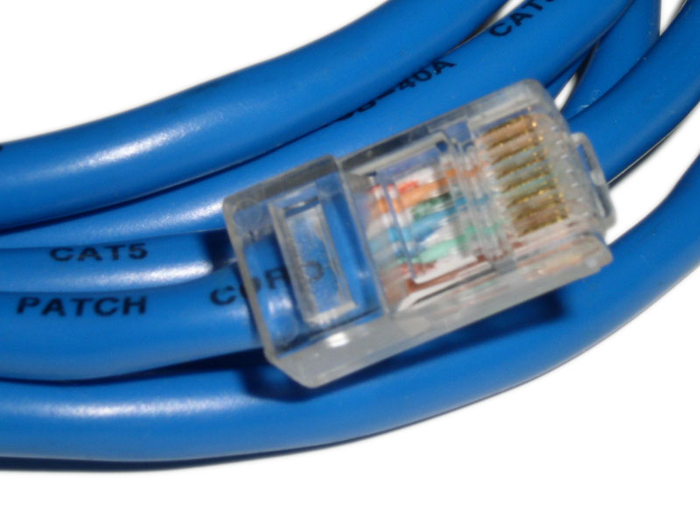
Ethernet and GIS
Data rates are 10, 100, 1000, and 10000
  10 = 10 Mb/s: Cat 3 cabling
  100 = 100 Mb/s, called Fast Ethernet: Uses Cat 5
  1000 = 1 Gb/s: Uses Cat 5E
  10000 = 10 Gb/s: Uses Cat 6 and Cat 6a

Slide 11
Gigabit Ethernet
Data rates of 1, 10, 40, or 100 Gbps
1 Gbps is supported by Cat5E cabling
  A good GIS workstation option
  Gigabit to the desktop
10 Gbps supported by Cat 6a cabling
Cat7 runs at 10 Gbps (shielded only (STP))
Cat8 is capable of 40 Gbps (STP)
100 Gbps requires fiber optic cabling

Slide 12
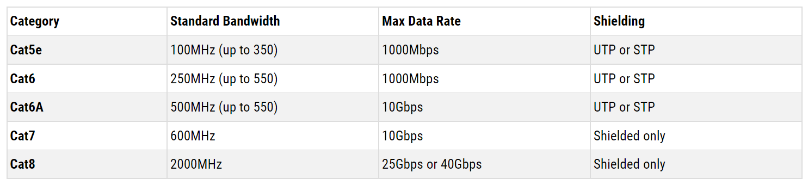
Comparing Ethernet

Slide 13
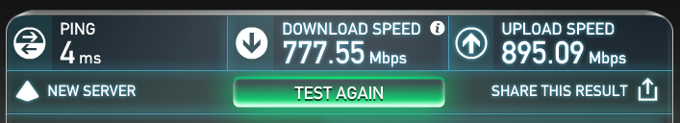
Quantifying Data Rate
Think of Data Rate (Gbps or Mbps) as describing the highway speed limit
To measure the actual speed messages are travelling is best described by PING (measured in milliseconds (ms))
Think of Ping as describing your car’s speed on the highway
Download and Upload (data rate) may be very different
Try it out at home using http://www.speedtest.net/

Slide 14

Understanding Data Rate
Your data (packet) will travel only as fast as the slowest component between the source and destination!
Bugatti’s top speed is 267.7 mph
Wooden carriage wheels top speed 15 mph

Slide 15
Do Some Math!
1 gigabit / second = 125 megabytes / second
  100 GB file = 100,000 MB
  800 seconds (100,000 / 125)~ 13 minutes
This is under ideal conditions
  No other traffic on your network
  You are allowed to saturate the network
  One file with a single open and close operation
  100, 1 GB files will transfer much slower due to I/O traffic (open and close for each file)

Slide 16
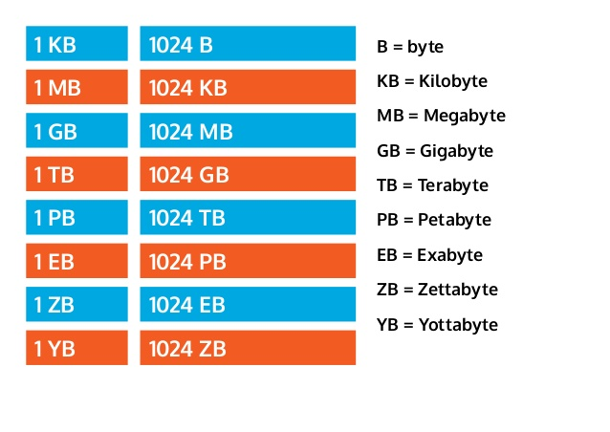
Orders of Magnitude
Factor of 1000

Slide 17
Ethernet and GIS
Ranges are 2, 5, T
  2 = ~ 200 m
  5 = ~ 500 m
  T = well… (for Cat 6/6a, T is about 100 m)
    It stands for twisted pair. Cable testing tools will determine how long a run can be and still pass “characteristics” test (based on standards)
    Runs as long as 150 m can be used (Cat 5e).

Slide 18

What’s Next…
Wi-Fi (wireless-fidelity)
Developed by Cisco, 3Com, Lucent, Nokia, and others
Specs are described under the IEEE 802.11 group.

Slide 19
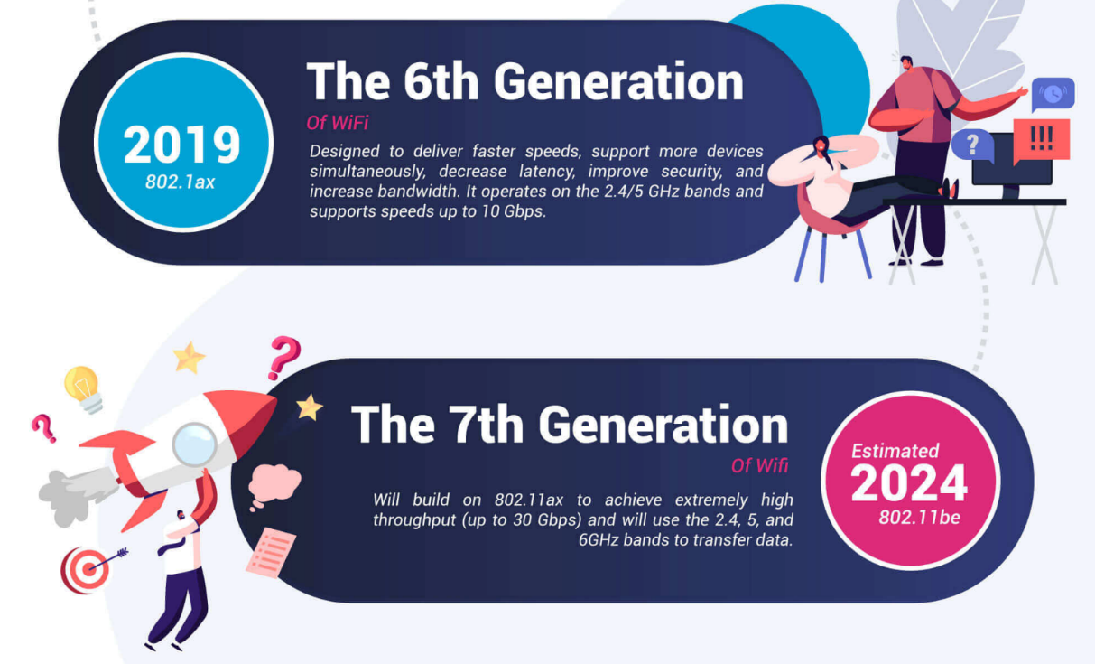
A Look at 802.11
https://www.signalboosters.com/blog/ieee-802.11-standards-explained-802.11abgnacax/
Achievable throughput
How do these compare for GIS???

Slide 20
Advantages/Limitations of Wi-Fi for GIS
Brain-storm
Advantages
  No cabling
  Fairly inexpensive
Disadvantages
  Security
  Traffic can congest at the 2.4 Ghz frequency
  Size of transmission (shared bandwidth)

Slide 21
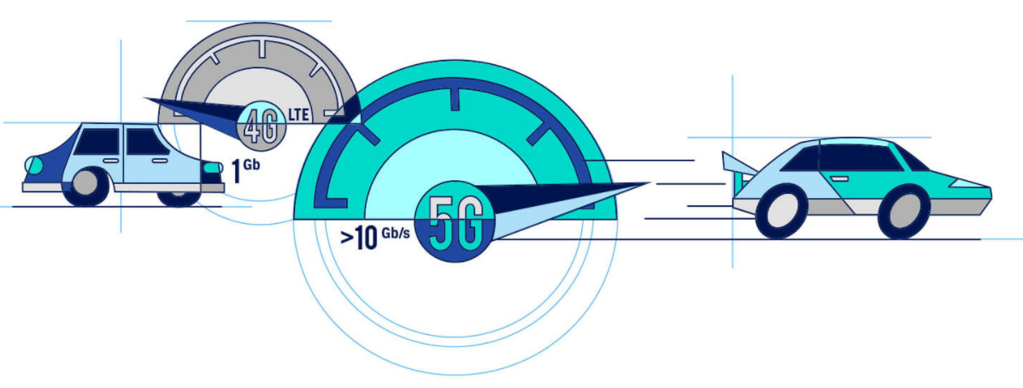
What About Cellular?
Wi-fi is NOT the same as Cellular
  4G LTE
  5G
https://www.cnn.com/interactive/2020/03/business/what-is-5g/index.html

Slide 22
Getting Data from Here to There
Recap…
  We know something about the history of networks
  We know about current Ethernet, Fast Ethernet, and Gigabit Ethernet technologies
  We know about Wi-Fi capabilities
These are the Data Link and Physical Layers, referred to as the Network Access Layer.
But, how does the GIS data get from here to there on the network?…regardless of the type of network
Notes:
OSI model splits the Network access layer into data link and physical layers. TCP-IP model uses the term Network Access layer.

Slide 23
Good Question!
Packets and Protocols
  TCP-IP is most common protocol
  Transmission Control Protocol- Internet Protocol
4. Application
3. Transport
2. InterNetworking
1. Network Access
1. Network Access
Notes:
TCP-IP is also called the DoD model. It was begun by the DoD under the DARPA project, defense advanced research projects agency. The DoD developed ArpaNET upon which the DoD model (TCP-IP) was designed to function.

Slide 24
InterNetworking Layer
Internet Protocol addressing
  Currently IP v4 is common. This is a 32bit system allowing 4.2B addresses.
    Example: 134.50.74.10
  IP v 6 is newer, 128-bit addressing. Allowing 2¹²⁸ addresses.
    Example: 00-B0-D0-86-BB-F7

Slide 25
Transport Layer
TCP
  Transmission Control Protocol
  Phases of operation
    Establish connection
    Transfer data
    Terminate connection

Slide 26


Application Layer
You know these well…
  HTTP
  SMTP
  FTP

Slide 27
Where’s the Network
Recap
  We have now learned how the data moves in packets from our computer through the layers of the TCP-IP model onto the Internet
But, where’s The Internet

Slide 28
The Internet Highway
From your workstation
To the LAN
To the Backbone at the Point of Presence
  AKA…ISP
  AKA…PoP

Slide 29
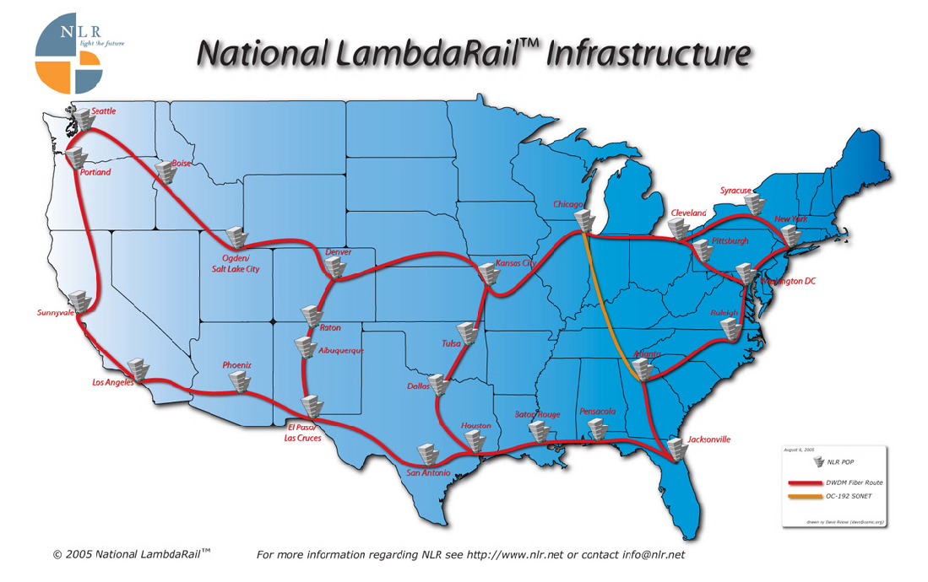
Various Backbones
Redundancy through
  ARPANet
  NSFNet
  Abilene (I2)
  National LambdaRail
What is IRON?
Notes:
Advanced Research Projects Agency Network (ARPANET )
Abiline is really a Qwest network

Slide 30
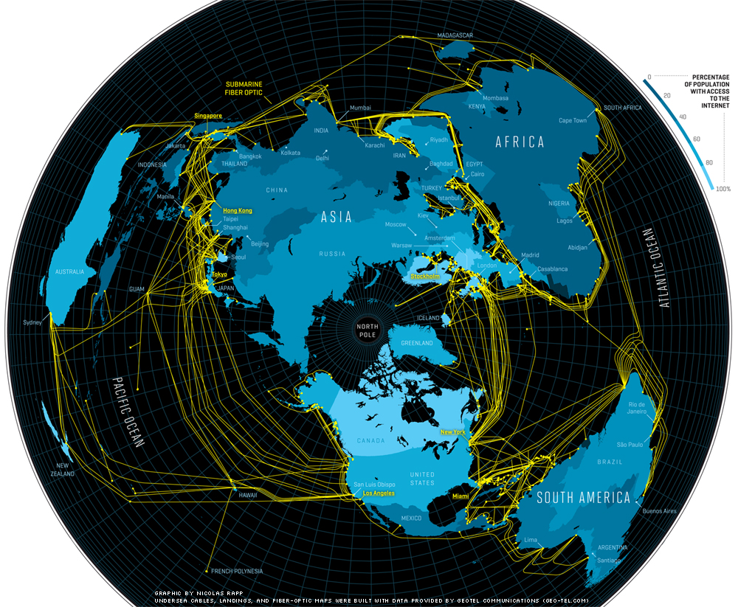
Undersea Fiber Optics

Slide 31
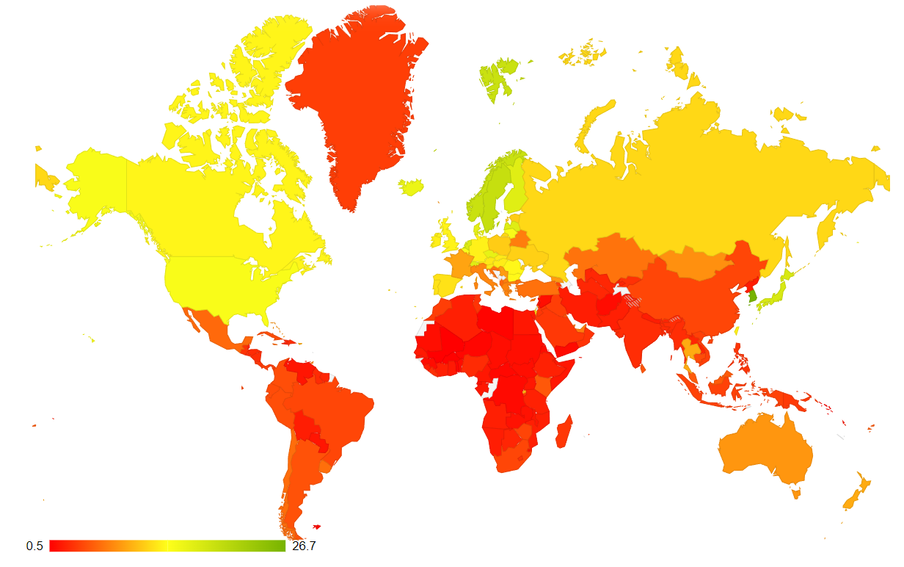
Internet Bandwidth (Data Rates)
https://www.fastmetrics.com/internet-connection-speed-by-country.php

Slide 32
We could go on forever…
For IT4GIS, we have gone far enough…
But today’s discussion of networks would not be complete without mention of the second-generation Internet, Web2.0

Slide 33
Web2.0
Is not :
  Internet2
  Is not hardware
  Is not software
It is…a whole new way that the Internet is used.
  Participatory
  Users are now “prosumers” instead of “consumers”

Slide 34
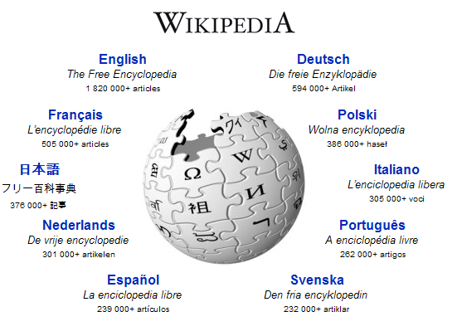
Participatory Web
Examples:
  Wikipedia
  Others?
What will this mean for GIS?
Notes:
The GeoWeb!

Slide 35
Web 3.0
We will cover this in greater detail later in the semester
For now, what was it and what is it today?
https://www.forbes.com/sites/forbestechcouncil/2020/01/06/what-is-web-3-0/?sh=68a3700e58df

Slide 36
The Web and AI
Is it the same thing?
  Not really, the emergence of Artificial Intelligence (especially AI browsers) reflects a change in how we analyze data
  AI browser is not about the delivery of data via the web
  It is all about the value of data collection

Slide 37
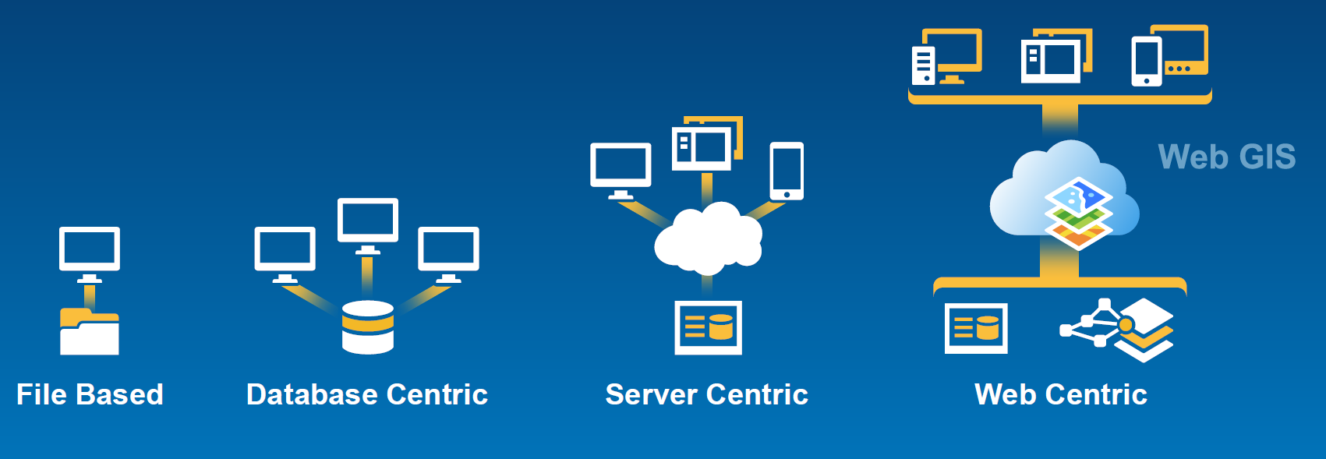
GIS and the Web

Slide 38

Key Concepts
Understand how data moves over a network
Understand the importance of data rate for GIS applications.
Watch the potential of wireless for GIS
Understand the roles of the various layers within the TCP-IP model
Understand new terminology like PoP and GigaPoP
The network is typically the bottleneck for GIS
Contemplate the affect of Web2.0

Slide 39
Questions…
Get ready for the 2-minute write
Notes:
Give tour

