Slide 1
Understanding RDBMS
IT4GIS
Keith T. Weber, GISP
GIS Director
ISU-GIS Training and Research Center

Slide 2
fundamentals

Slide 3
RDBMS
Relational Database Management System
The “I” in GIS (Information)
Notes:
Have you heard of relational database management systems (RDBMS). In a nutshell, an RDBMS is one database with any number of associated and related tables. We will not be dealing with RDBMS in this class other than a few comments here and there. However, it is important you know what this abbreviation means.
Similarly, the next generation of RDBMS’s have been structured to follow an object-oriented design. These databases, when the technology matures, will be very powerful indeed.
I f you are interested, we will deal with RDBMS in the Advanced GIS course.

Slide 4
BTW
The Data-to-Wisdom Pathway
Data Information Knowledge Wisdom
cf., https://en.wikipedia.org/wiki/DIKW_pyramid
Notes:
Databases comprise the information part of Geographic Information Systems. We need databases, and we need to understand databases.

Slide 5
Database software...
Light Duty
Medium Duty
Heavy Duty
Notes:
Can you give me some examples database software on the market today?
Have you ever heard of Access, Paradox, SQL Server, Sybase, or Oracle?
Have you heard of Excel and Quattro Pro? Excel and Quattro Pro are spreadsheets which are often used in lieu of real database software.

Slide 6







Database software...
Light Duty
Medium Duty
Heavy Duty
Notes:
This diagram shows the relative power or ability of various software packages. For database applications, software such as Excel or Quattro Pro are relatively light duty. Typically, spreadsheets can only contain about 32,000 records --which is not enough in a lot of GIS applications.
Medium Duty software such as Paradox and Access are good databases (and true databases) but they lack some of the enterprise scaling capabilities of the real heavy-hitters in Databases, Oracle, Sybase, MS SQL Server, and IBM’s DB2.
Can you tell me what the difference is between a spreadsheet and a database?

Slide 7
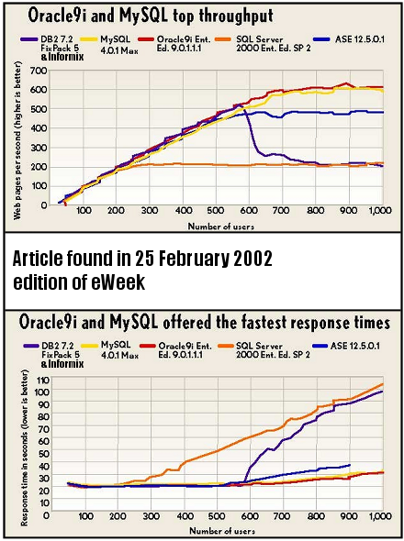
Relational Databases
Why are databases important?
  Drive many business processes
  Store large amounts of data
  Retrieve data quickly

Slide 8
Spreadsheets vs. Databases
Integrity!
Structure
Notes:
We have already talked about a limited number of records which can be handled by the spreadsheet software but that is not the major difference. The major difference really revolves around integrity.
Integrity refers to rules that have been established to ensure relationships are valid, or that each attribute of an entity is entered properly and within the realm of its possibilities. For instance, when you work in a spreadsheet, even when you treat it as a database, you can enter all the data you wish in your rows and columns and then off to the side you can add some numbers, or perform a function of some sort. Well, in a true database, those notes --even if they are not intended to be permanent-- violate the integrity of the database and are not allowed.
As you can see, databases are far more structured and for that reason, some people find them harder to use.

Slide 9
RDBMS Concepts and Terms

Slide 10
Independence
Physical
Logical
Notes:
Physical independence…the RDBMS is not dependent upon only one physical platform (e.g., VAX 300 mainframe, UNIX, etc.)
Logical…changes can be made to the logical structure (tables added, removed, split) and the system still functions.

Slide 11
Logical Consistency Example
Character based database design
  FirstName (1-4)
  LastName (5-10)
  Address (11-46)
Record #1: Paul Bunyun, 100 Main Street, Pocatello, ID 83201
NOTE: Record #2 starts at character #47

Slide 12
What Happens When We Add a New Field?
New Field = ZIP+4 (47-50)
  Example, Paul’s ZIP+4 = 1234
Scripts written and referring to the original design will fail
Record #1: Paul Bunyun, 100 Main Street, Pocatello, ID 83201
Record #2: 1234 Johnhe, nry 150 Main Street, Pocatello, ID 8

Slide 13
Integrity
Important for consistency and transaction management.
Types:
  Domain: all values come from predefined domains or are null
  Redundancy: problems can occur as a result of repetitive storage that is not consistently updated and from stored data that is derived from other stored data. Redundant data must be consistent.
Notes:
Domain- all values come from predefined domains or are null
Redundancy- problems occur as a result of repetitive storage that is not consistently updated and from stored data that is derived from other stored data. Redundant info must be consistent.
Constraint- AKA Business integrity. Stored data must not violate business rules.
Entity- every record must be uniquely identifiable
Referential- interrelationships must be rigorous and not ambiguous.

Slide 14
Integrity Types (cont’d)
  Constraint: Business integrity. Stored data must not violate business rules.
  Entity: Every record must be uniquely identifiable (index field or ObjectID)
  Referential: Relationships must not be ambiguous. Two types…
    Cascading or non-cascading

Slide 15
Enforcing Integrity Rules
Programmatic
Systematic

Slide 16
Key Fields versus Index fields
Unique Identifiers are Index fields
Relate fields are Key fields
  Primary key
  Foreign key
Notes:
How will we be able to connect the information in this database table to the geographic elements in the GIS?
To do this we use Unique Identifiers in some sort of key field. Remember how each point has an ID number. Well, each record in the database table should have the same number. In this way, the Point representing the downtown McDonalds or Burger King will be correctly associated with the database records for their restaurants. To add a Unique_ID to your database table simply requires forethought and planning on your part and the creation of a field called Unique_ID (or Restaurant_ID, or something of this sort). In GIS, you should always use a number as your Unique_ID!

Slide 17
RDBMS Structure

Slide 18
Database Tables
Database
Table1
Table2
Table3
Notes:
Each collection of records and fields is called a table. Numerous tables can make up a single database.

Slide 19
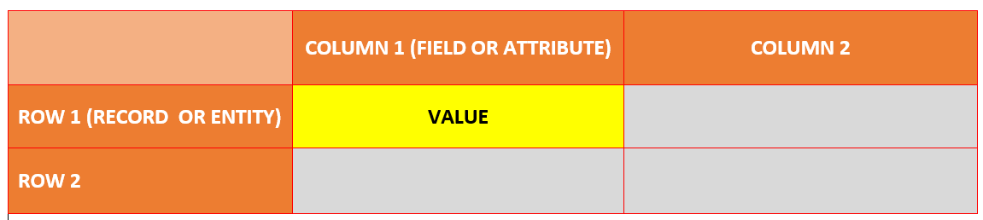
Table Structure
Notes:
Databases consist of rows and columns called records and fields. The intersection of one record and one field is called a value, regardless of whether the ‘cell’ contains a name or a number.
Note: Values that use words are called Strings, while values that use numbers are called Numeric. These are the two basic types of values. There are also special values like Dates, Currency, and Time.

Slide 20
Data Value Types
Type Name | Storage Occupied/ data value | Valid Domain Range
Short Integer | 2 bytes | -35768 to 32767
Long Integer | 4 bytes | -2147483648 to 2147483647
Float | 4 bytes | Any number from n⁻⁴⁵ to n³⁸
Double | 8 bytes | Any number from n⁻³²⁴ to n³⁰⁸
Text (string) | 10 + max. length = bytes | Any alphanumeric characters
Date | 8 bytes | Jan 1, 100 to Dec. 31 9999
LOB (variant) | 22 + max. length = bytes | Any alphanumeric characters
Notes:
LOB- large object
BLOB, binary large object
CLOB, character large object

Slide 21
(BTW) Raster Data Types Worth Knowing
1_BIT—A 1-bit unsigned integer. The values can be 0 or 1.
2_BIT—A 2-bit unsigned integer. The values supported can be from 0 to 3.
4_BIT—A 4-bit unsigned integer. The values supported can be from 0 to 15.
8_BIT_UNSIGNED—An unsigned 8-bit data type. The values supported can be from 0 to 255.
8_BIT_SIGNED—A signed 8-bit data type. The values supported can be from -128 to 127.
16_BIT_UNSIGNED—A 16-bit unsigned data type. The values can range from 0 to 65,535.
16_BIT_SIGNED—A 16-bit signed data type. The values can range from -32,768 to 32,767.
32_BIT_UNSIGNED—A 32-bit unsigned data type. The values can range from 0 to 4,294,967,295.
32_BIT_SIGNED—A 32-bit signed data type. The values can range from -2,147,483,648 to 2,147,483,647.
32_BIT_FLOAT—A 32-bit data type supporting decimals.
64_BIT—A 64-bit data type supporting decimals.

Slide 22
Making Sense of all this…
Recall, there are 8 bits in 1 byte
Cross-reference
  8-bit is byte data
  16-bit is short integer (2 bytes)
  32-bit (signed or unsigned) is long integer (4 bytes)
  32-bit (float) is single-precision floating point (4 bytes)
  64-bit is double-precision floating point (8 bytes)

Slide 23
Database design

Slide 24
Basic Steps in Database Design
Understand and document the business’ needs.
  Problem statement
  Business object types
  Business relationships
  Business constraints
Create an ERM
Data and process inventory
Develop tuple types
Tuple types to tables
Integrity
Populate the database
Notes:
Entity relationship model- a model that graphically expresses the business. It is not a database model.
What are tuple types: they are logical (not physical) datasets. They represent a class with the same meaning, structure, and characteristics. Contains a set of attributes. Relationship types and entity types can be tuple types. During this step, we decide which entity types and rel types will become tuple types. Part of this process includes normalization.

Slide 25
Reading a Business Statement

Slide 26
Identify Candidate Classes
A candidate class may or may not remain a class throughout the design process
  A candidate class may or may not become a table
Try not to think about tables when reading the business statement at this point

Slide 27
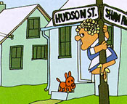

Think Object-Oriented
Classes are nouns
A noun is a “person, places, and things”

Slide 28
Methods
Identifying candidate methods allows us to better understand how the business operates and how the Enterprise uses GIS data.
A method is a behavior…a relationship between classes
Ultimately, a connection between two tables
The candidate methods will describe an inheritance, aggregation, or dependency relationship
Notes:
Inheritance…is a relationship
Aggregation…has a relationship
Dependency…uses relationship

Slide 29

And now…Verbs
Candidate methods are verbs
  They show action
  They are behaviors

Slide 30
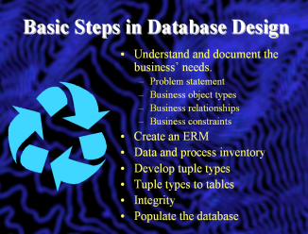
Create an Entity Relationship Model (ERM)
Symbolized.
  Standard Representation
  Attribute Representation
  Entity Instance Representation
DINING
BUILDINGS
DINING
K BldgNum: 126
K Restaurant Number
Name: Graveley Hall
Type: Education
Name
Type of food
Notes:
Entity types (box with entity type name…from object type)…this is standard representation
Alternatively, we can represent the attributes as well (attribute representation).
To better understand the business, an entity instance review can be useful.

Slide 31
Relationships
Determine the Relationship between Entity Types.
Add these to the ERM
(more about database relationship classes later in the semester)

Slide 32
Data and Process Inventory
Database Dictionary
  BldgName
  Type
  Floors
The name of the building
Primary use of the building (e.g., 0 = Unknown or n/a; 1 = Education, 2 = Offices, etc.)
The total number of floors
Notes:
A database dictionary describes the attribute. What does the field name really mean, what kind of data values will be recorded, how are the data values measured, estimated, or set. All these type of information should be recorded in your database dictionary.
Note: these are also an important to of geo-spatial metadata, which I will discuss later.
Now what do we do? If we were creating a relational database then our next step would be to organize the list of attributes into separate tables. For instance, all information regarding the location of the restaurant could be placed in a Restaurant_Location table, all attributes describing costs of the restaurant could be placed in a Restaurant_Costs table, an so on.

Slide 33
Develop Tuple Types
Use your ERM with relationships
Perform a “Walk-through” exercise
  Simulate data is being added/retrieved in your database.
Create another, more matjure ERM using Attribute Representation

Slide 34
Tuple Types to Tables
ENTITY TYPES
TUPLE TYPES
TABLES
RELATIONSHIP TYPES
Notes:
Tuple types represent a group of objects with the same meaning, structure or characteristics. They consist of a set of attributes.
A tuple is a specific instance of a tuple type.
All entity types will become tuples…most relationship types will also become tuples.
How do we know?
The first step to guide us is Normalization!

Slide 35
Normalization
First-Fifth Form Normal (1FN , 2FN ,…5FN)
Academic
Applied
Notes:
Use poster

Slide 36
1FN
“All values are atomic”
  Each cell in the table contains only a single data value
Eliminate repeating groups
  Puppy_Trick1, Puppy_Trick2, …
Note: some tables will be OK as planned… just check to make sure.
Notes:
Alll atttributes can have at most, one value.

Slide 37
Check this (1FN)…

Slide 38
2FN
Satisfy 1FN and…
Redundant data must be eliminated
  How?
  Example: Puppy_ID, Trick_ID, Trick_Name
Notes:
If your tuple has only 1 key field, then 2FN is automatically satisfied.

Slide 39
Check this (2FN)…

Slide 40
3FN
Satisfy 1NF and 2FN and…
No non-key attributes are dependent on other non-key attributes.
  Example: Appointment_ID, Name, Date, Time, Species

Slide 41
After Normalization
New tuple types will be created.
New tables will be planned.
Many-many relationships will be handled using associative tables (bridge tables).

Slide 42

De-Normalization
What? Is this heresy?

Slide 43
Designing the Actual RDBMS
Visual modeling based upon your ERM and Tuple type model.
Implementation of integrity rules based upon your business constraints.

Slide 44
Populate the Database
Questions and concerns to revisit
  Null data
  Reporting discrepancies and variations
  Measuring or estimating methods
  Client utility/efficiency
Notes:
Now what do you do?
Well, now it is time to create our database table on the computer and then populate that table (add attributes) using the data we collected or assembled.
Surely, you will encounter some problems. Here are some likely concerns you will face:
Null Data: what do you do if some restaurant managers do not report information for one or more fields? Do you throw out the restaurant from your database? Do you enter ‘0’ or leave the value blank?
Each of these concerns requires anticipated contingency planning on your part. Throwing away the data or entering a zero is not the best solution, and neither is leaving it blank. Each can cause problems in the later use of your database. The best solution is to document a code in your database dictionary which will be used to represent null data. Give the selection of your null string some serious thought because you do not want to confuse it with real data at sometime in the future.
Reporting discrepancies and variations: What if 1 restaurant manager report the average cost of a meal is $7.00 and another reports $7.23? What if one reports that his restaurant serves “American” food and another reports that her restaurant serves “American Continental”
Measuring and Estimating Methods: Are you going to classify or rate the atmosphere? Who will do this work? Are data going to be collected by teams with varying standards or abilities to correctly measure or estimate the parameter?
As you can see, anticipating these types of common problems before beginning your data collection and data entry is really critical.
Let’s say you have entered all the data and have completed all the steps to this point! Now what?

Slide 45
The Last Step?
Validation!
Notes:
We are not finished yet. The last step is to validate the information we have entered. Are there any typo’s, errors, etc. This step is truly critical to the efficiency of the database.
True, you can create a database without following any of these steps, but you will regret it because it will be sloppy and slow, and your user’s may secretly dislike you for your lack of planning.
If you have any questions please contact me.
YOUR ASSIGNMENT: Read chapters 5 and 6 from the Clarke text, and chapter’s 5 and 6 from the ESRI text.

Slide 46
Professional Hints and Tips
Using Google drive, sharing files/folders and communicating this in email

Slide 47
Questions?

